Slide 1
Sharing the Road with Large Vehicles
Instructor Slides

Slide 2
Using the scrap paper on your desk, list as many large vehicles as you can.

Slide 3
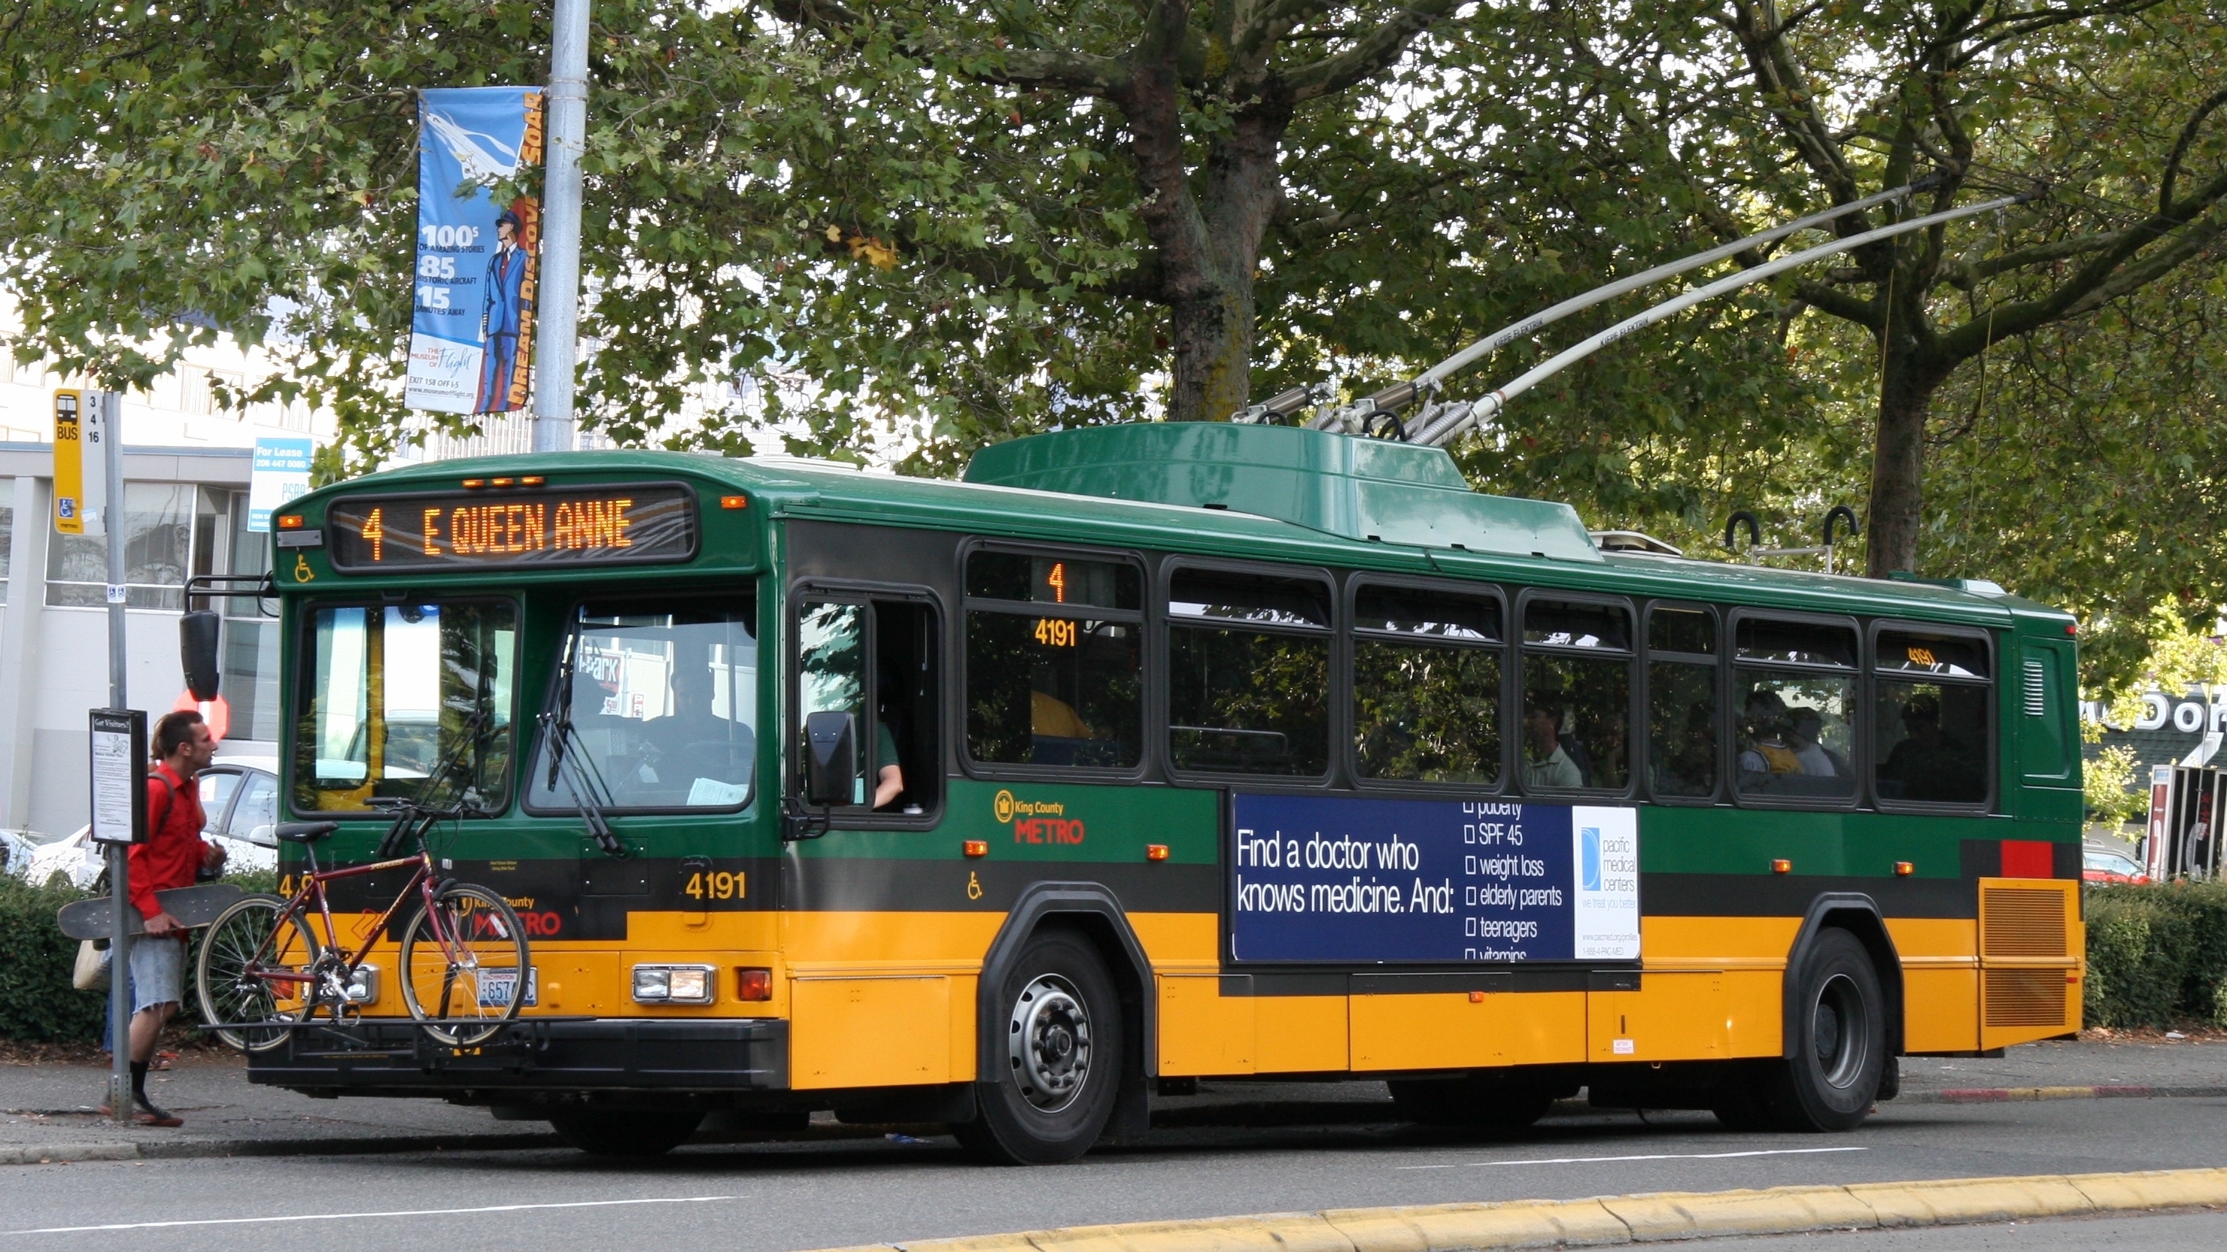
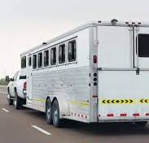
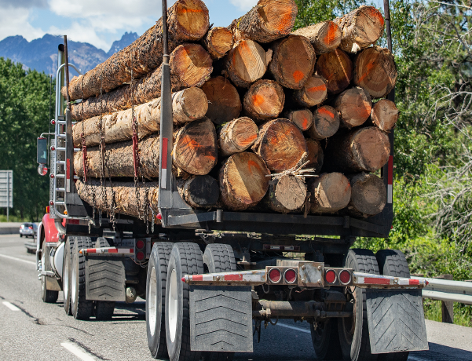
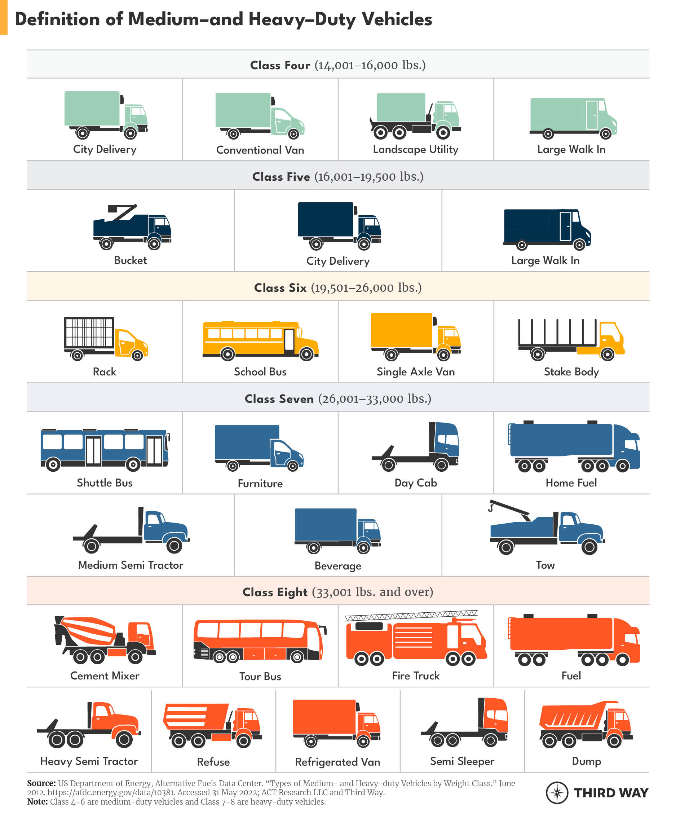
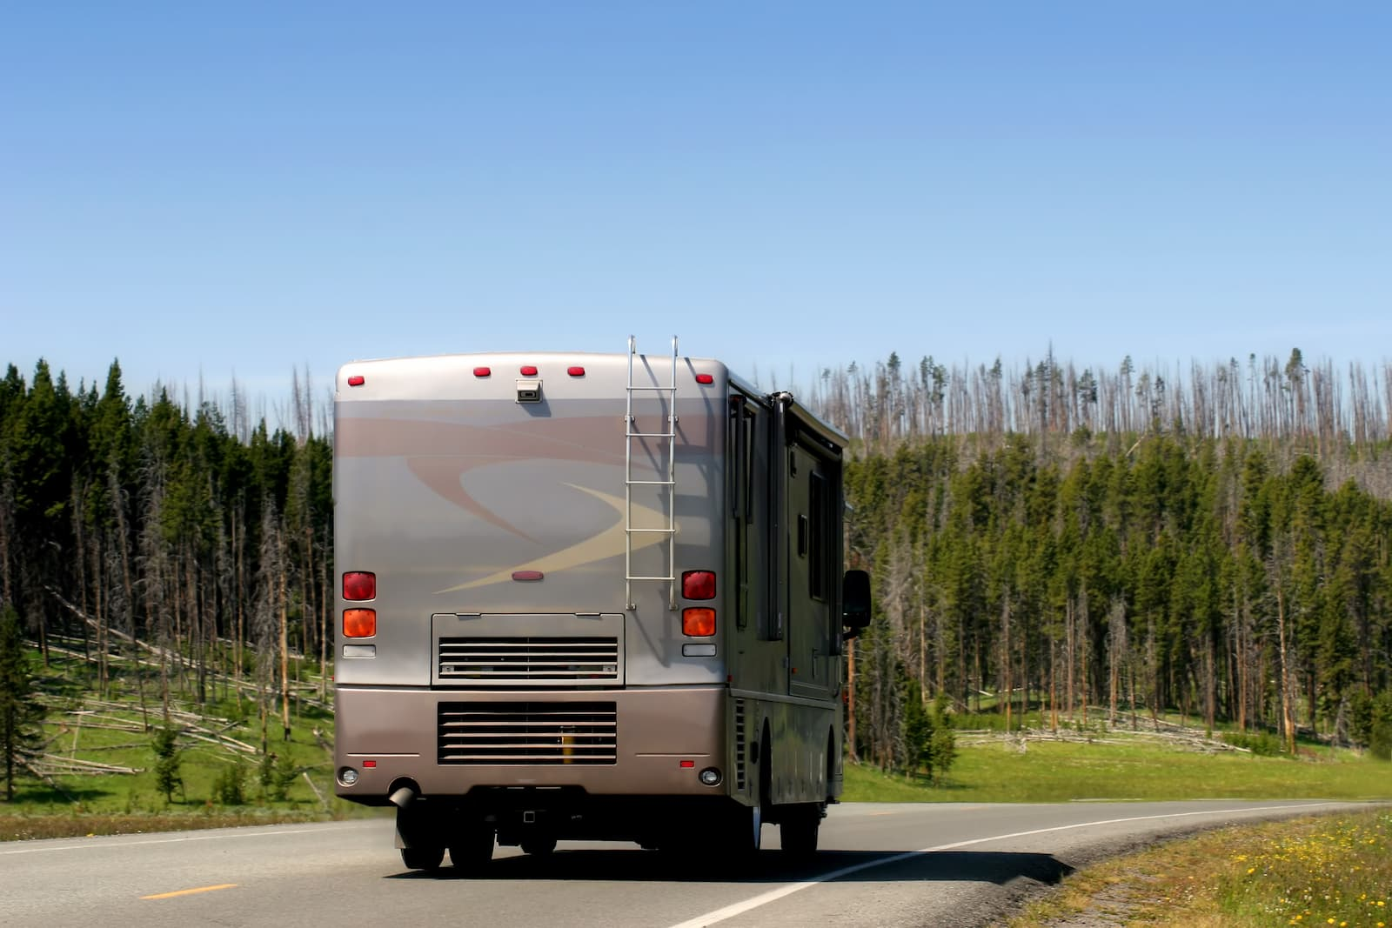
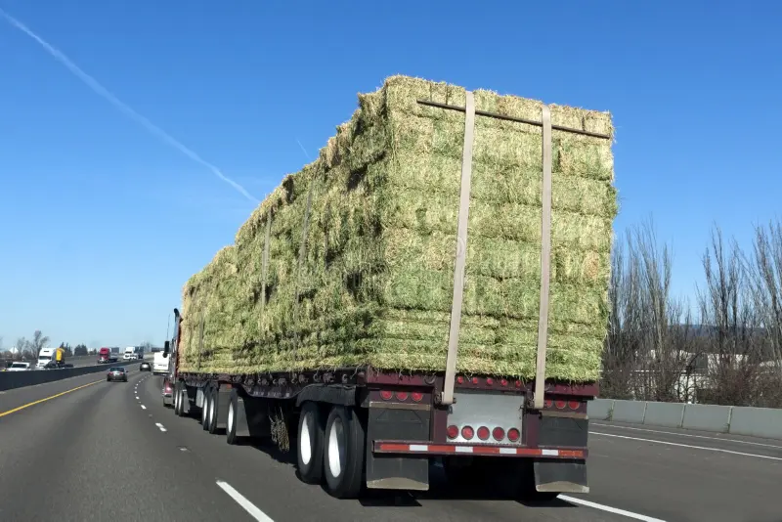
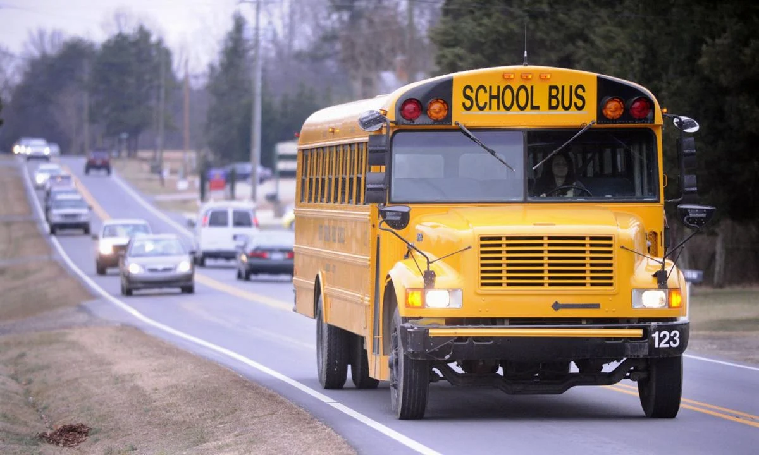
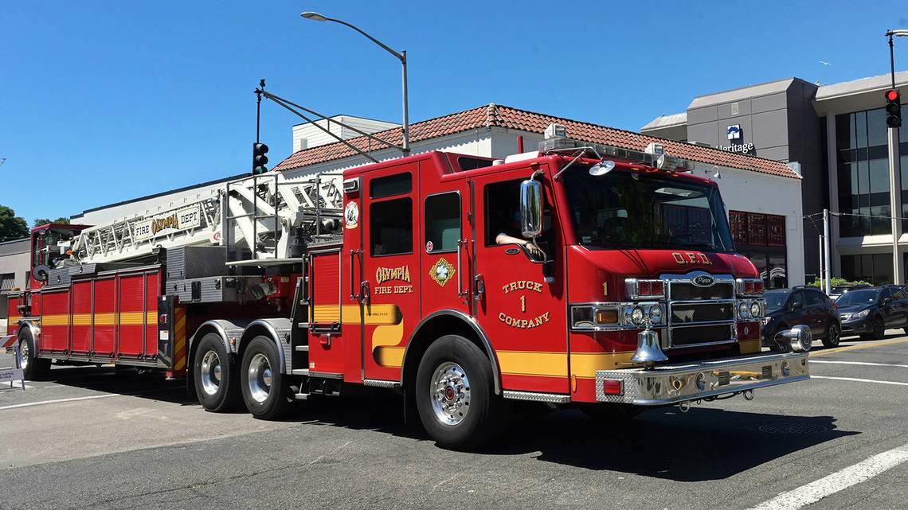
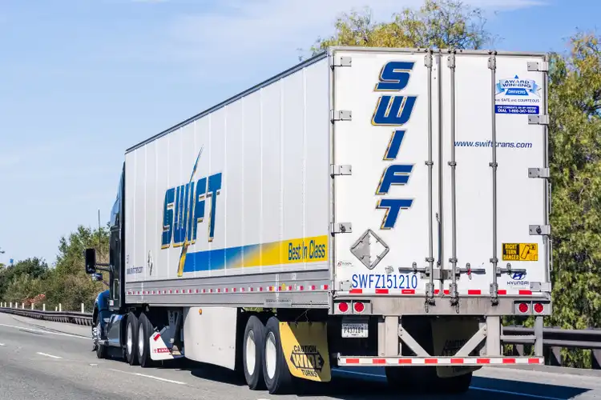
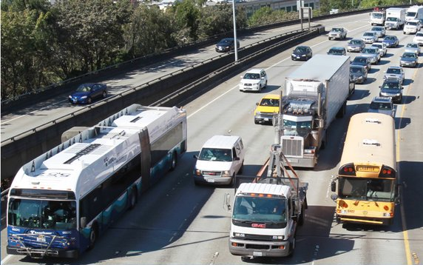
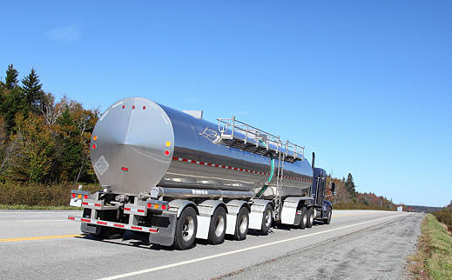
Notes:
Here are a variety of large vehicles you may encounter on the road. The vehicles on the left are often seen on Washington roadways.

Slide 4
Why is it important to know how to share the road with large vehicles?

Slide 5
Driver Guide
Section *4.40
Notes:
Please find section *4.40 in your driver guide to follow along throughout the lesson. You are encouraged to take notes in the margins. Write down anything that will help you remember how to share the road with large vehicles.

Slide 6
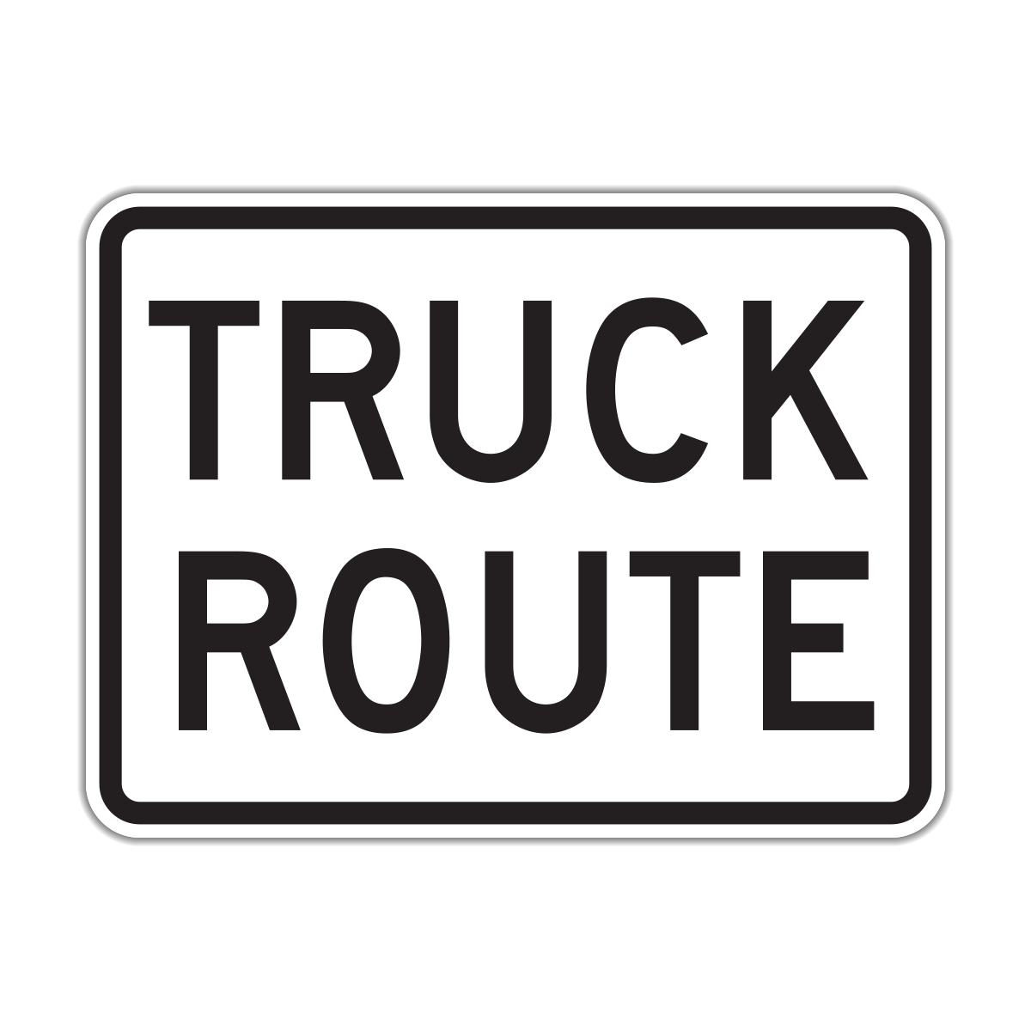
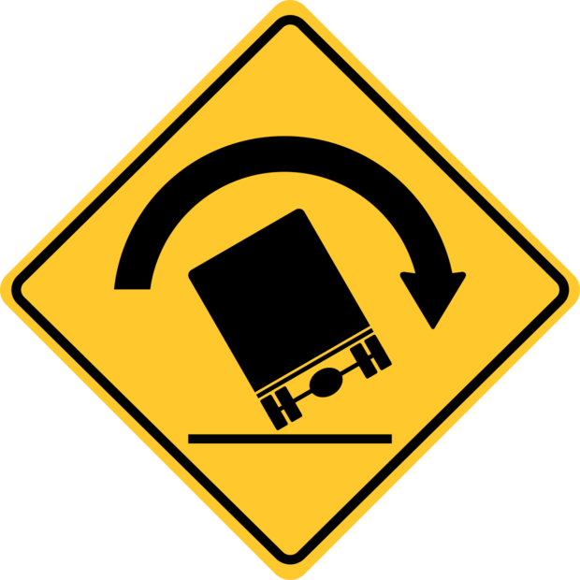
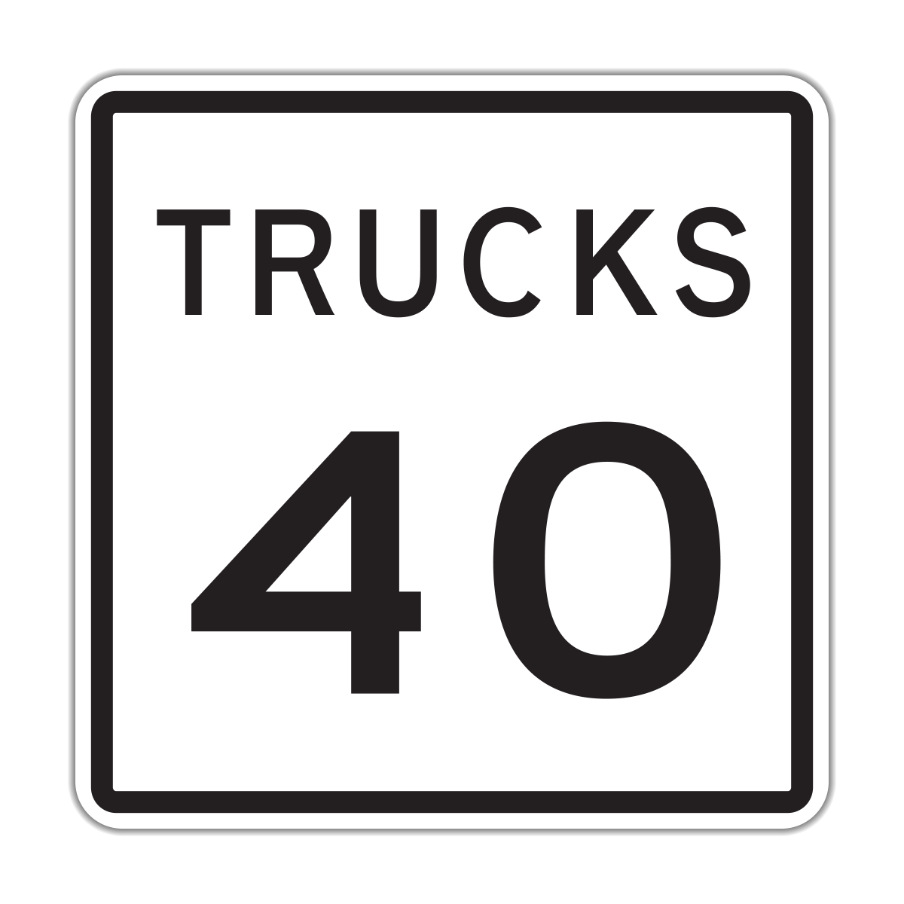
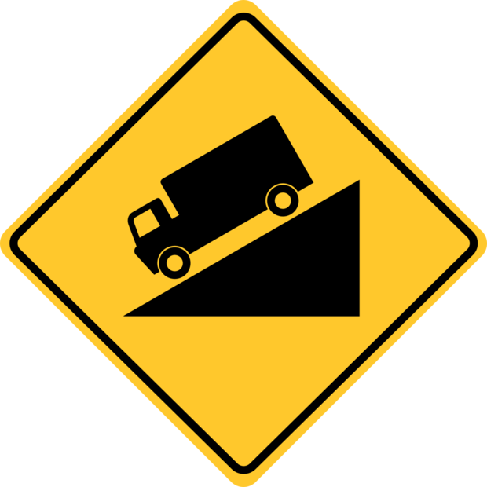
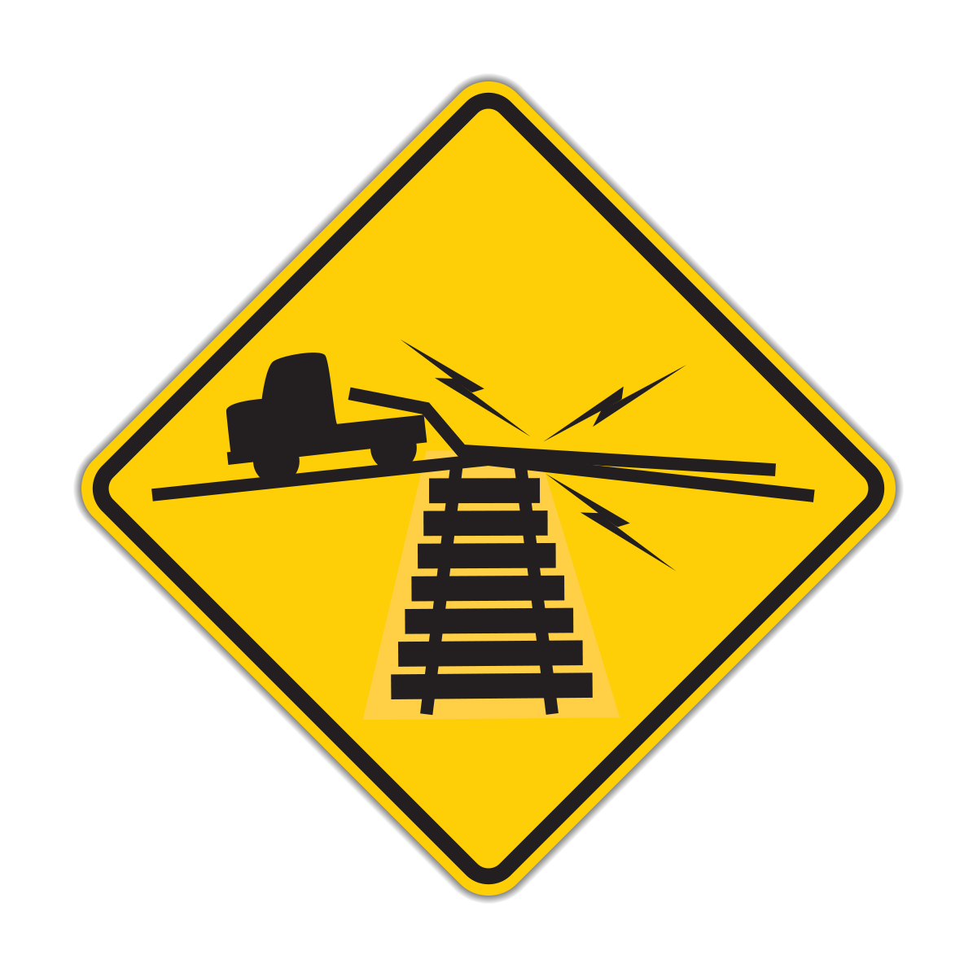
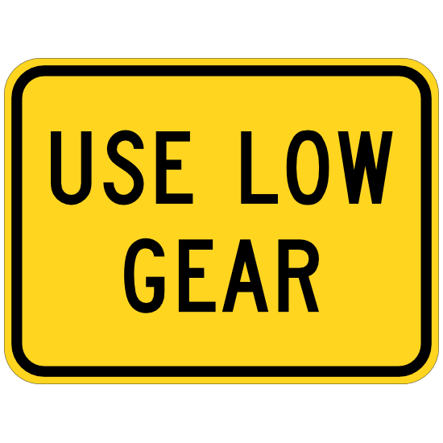
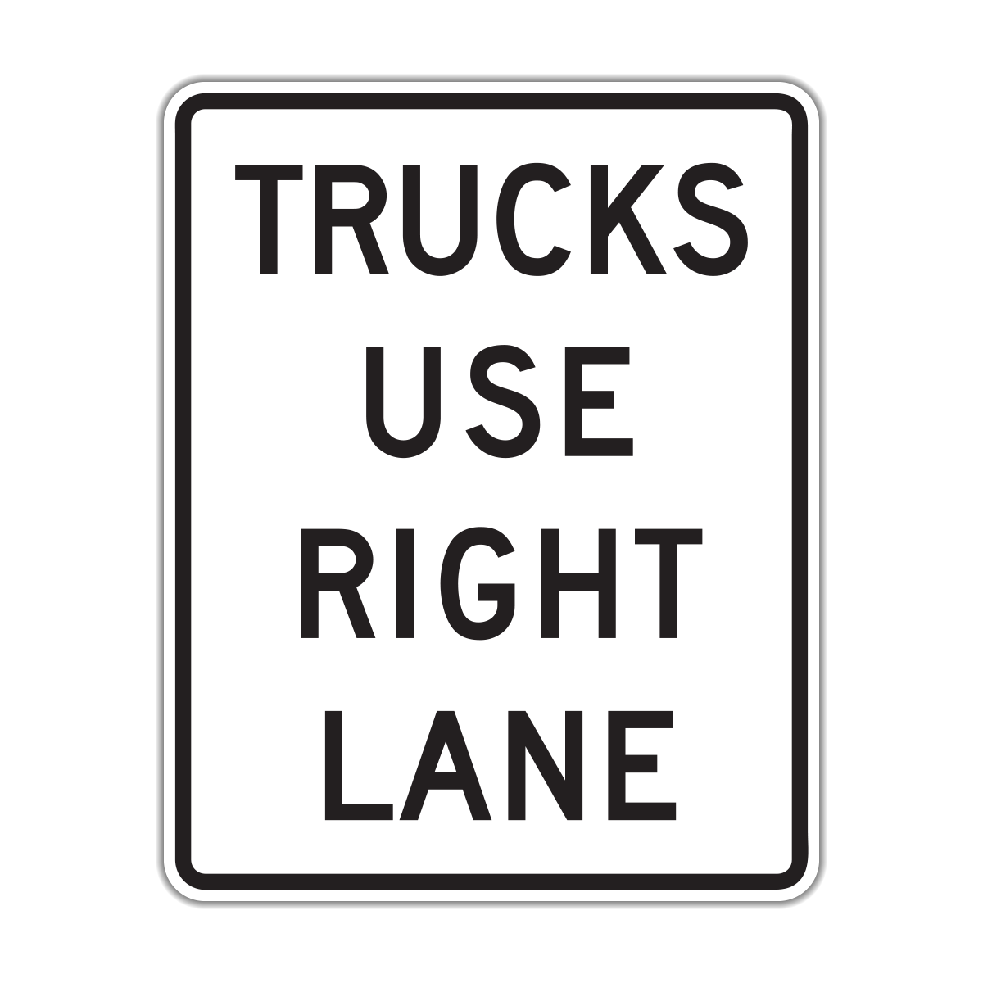
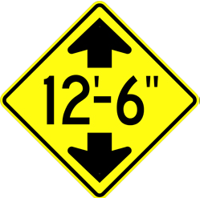
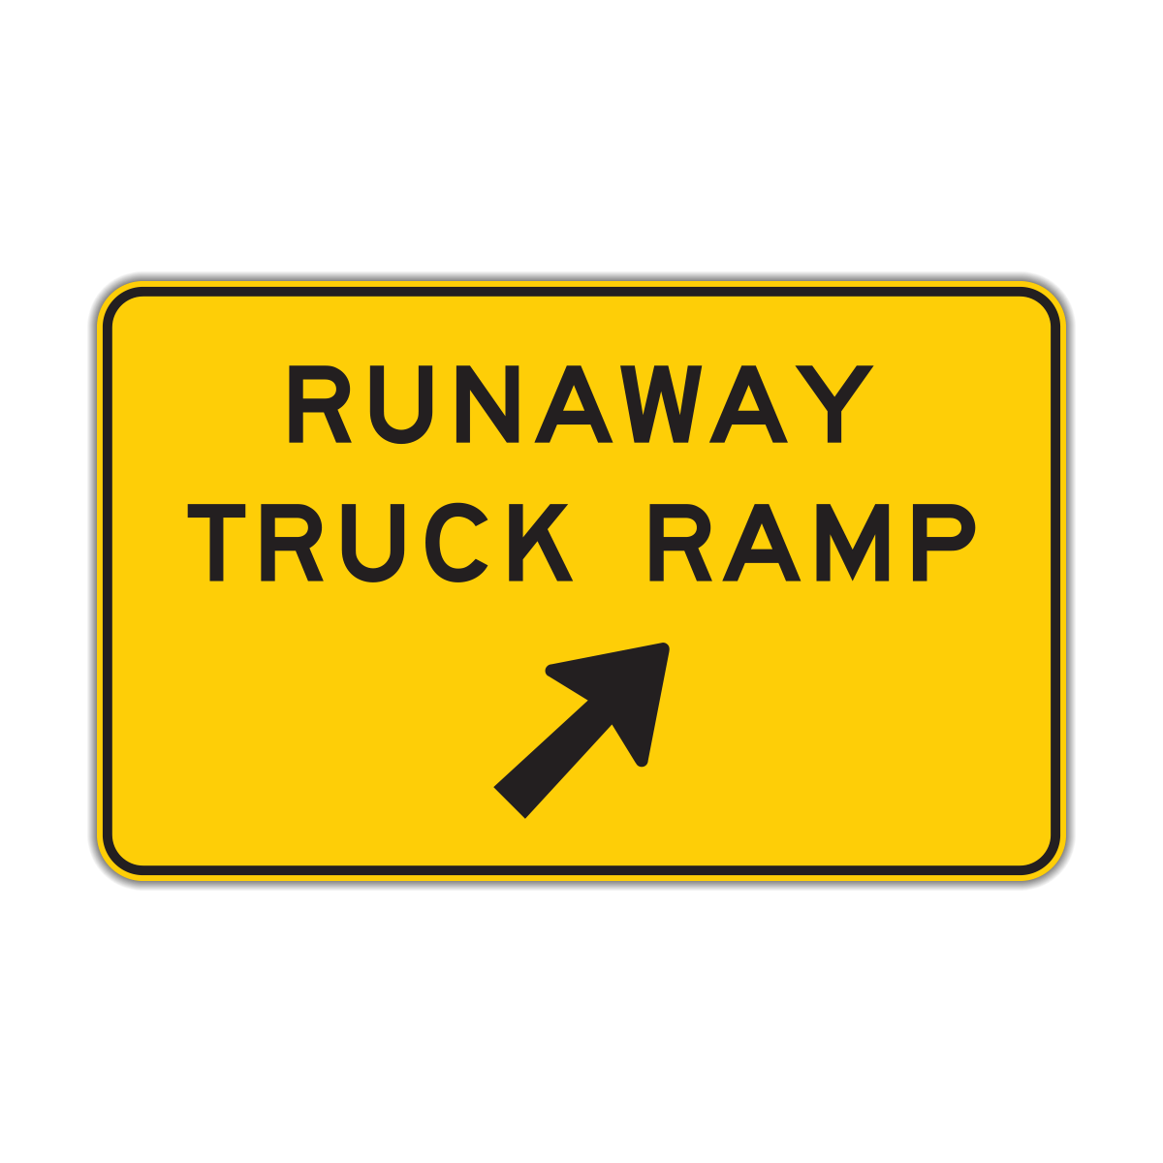
Notes:
While traffic and road signs are for all drivers, there are specific signs that are more applicable to large vehicles. Some of these signs include:
Steep Grade – take precautions and be prepared for the effects of this grade on the truck; braking and possibly gearing down to slow the engine
Rollover Potential – highway design or condition may make the potential for a shift in stability of the vehicle resulting in a rollover
Low Ground Clearance – know the truck’s dimensions above as well as below the truck. Slow down when crossing this area.
Maximum Height Warning – know the truck’s dimensions and know the route. The driver may need to determine an alternate route
Truck Route – the route, while used by others is designed for trucks because of highway design, traffic patterns, and construction specifically done to handle truck weights and high volume. Other highway users need to be prepared to drive with large trucks and know their handling.
Trucks Use Right Lane – trucks on this roadway are to use the right lane because of highway design or grade, etc. Multiple trucks in this lane may slow traffic. Drivers should use caution when passing and returning to the lane shared with trucks. A truck may still come into the left lane.
Runaway Truck Ramp (Distance 1 mile) – in some areas where steep grades have the potential to result in a truck speeding out of control or having brake failure, designated areas have been placed so trucks may use them in case of an emergency. These ramps may be used by cars in the event of brake failure or speeding out of control.
Use Low Gear – lower gears are needed on steep or winding roads. This sign alerts drivers to the need for lower gears on this roadway. It is a warning to all drivers of the potential to create an emergency.
Reduced Speed Limit for Trucks – in some areas, trucks need to drive slower than other vehicles. This sign warns truck drivers to slow down to posted truck speed.

Slide 7
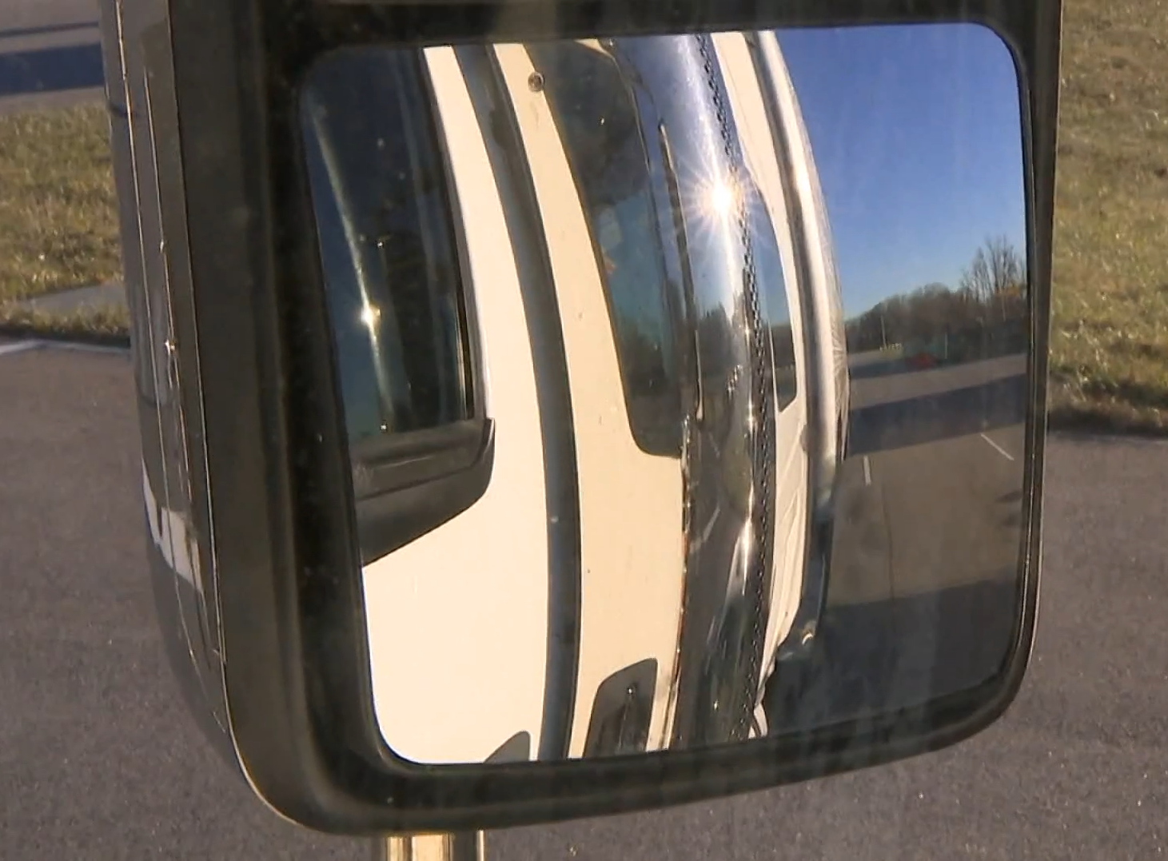
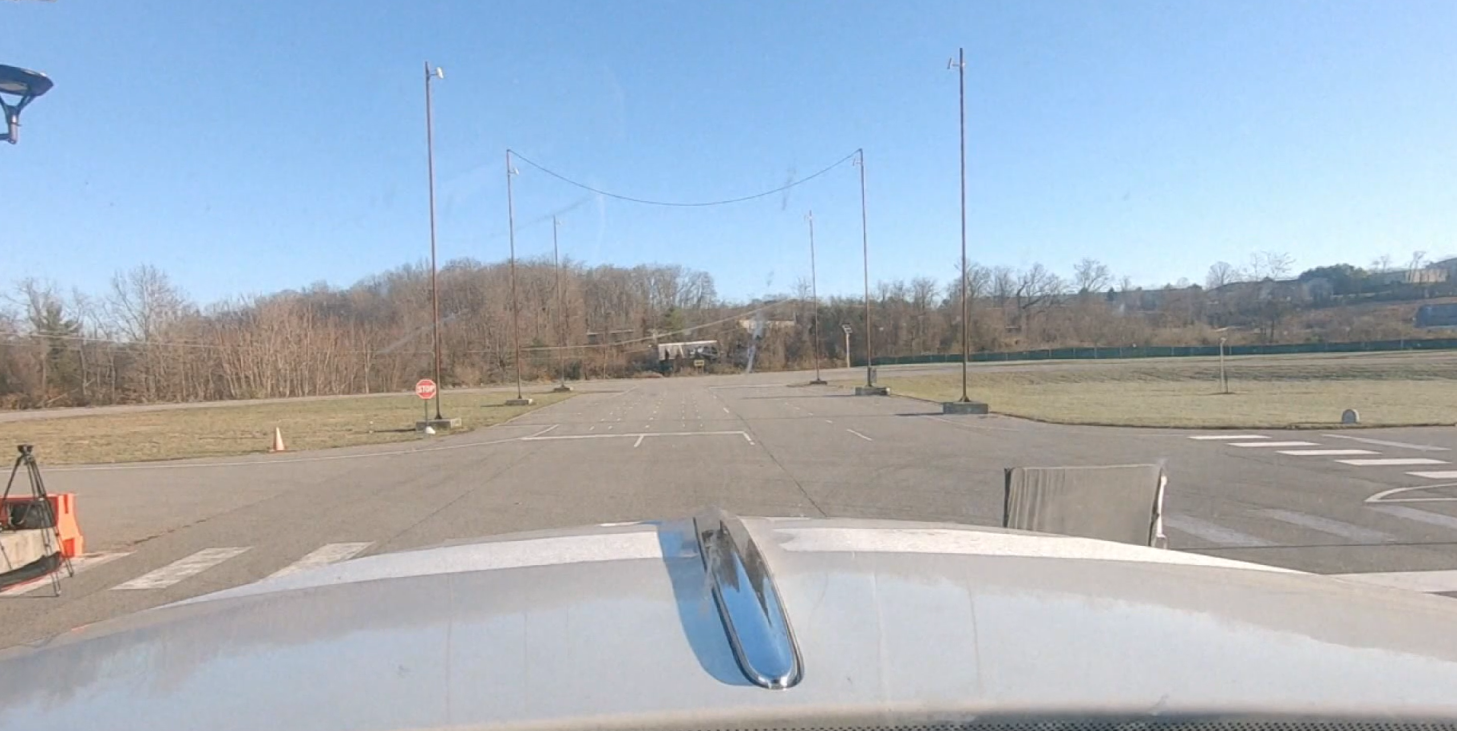
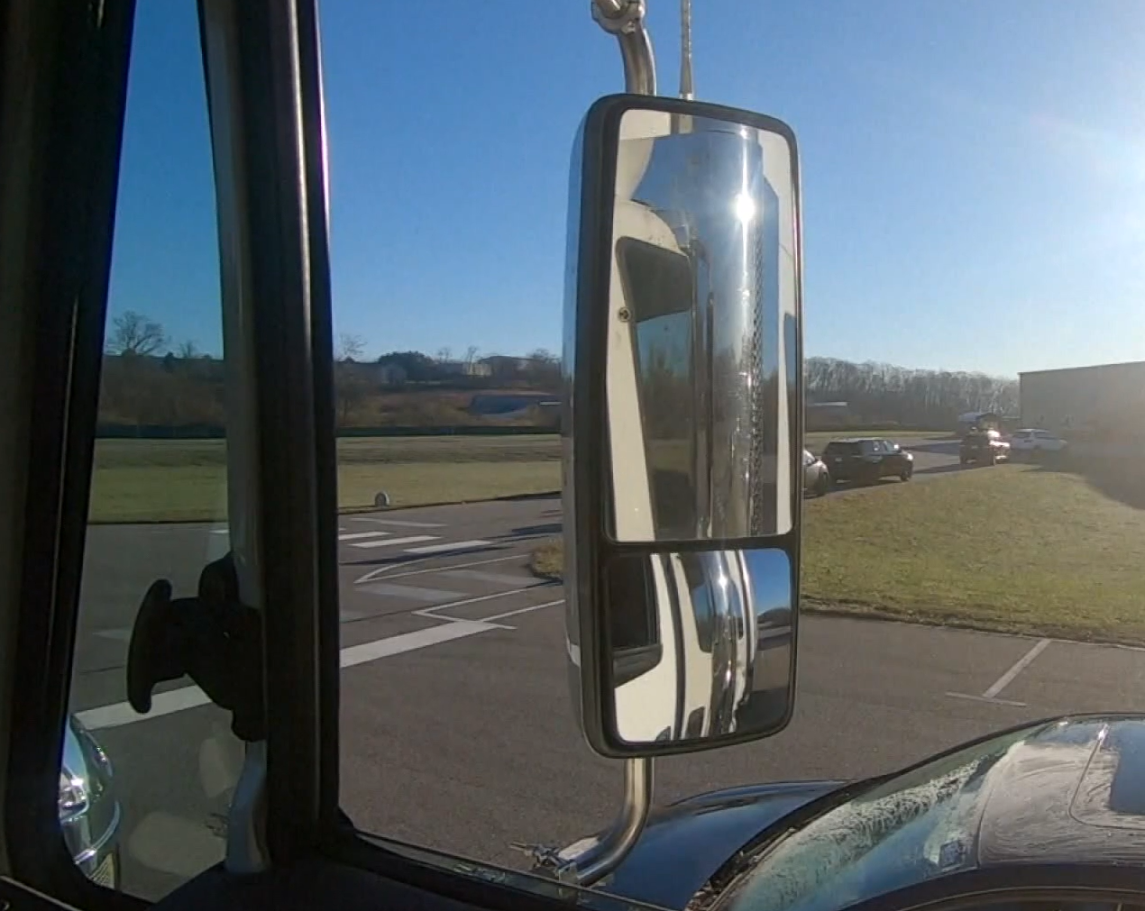
POV: driver’s seat of CMV
How many vehicles do you see?
VISIBILITY
Notes:
Pretend you’re sitting in the driver’s seat of this CMV. Looking ahead and into the side mirrors, there doesn’t seem to be much traffic. There is a car to the driver’s right, and a few others traveling away from the CMV. How many vehicles do you see?

Slide 8
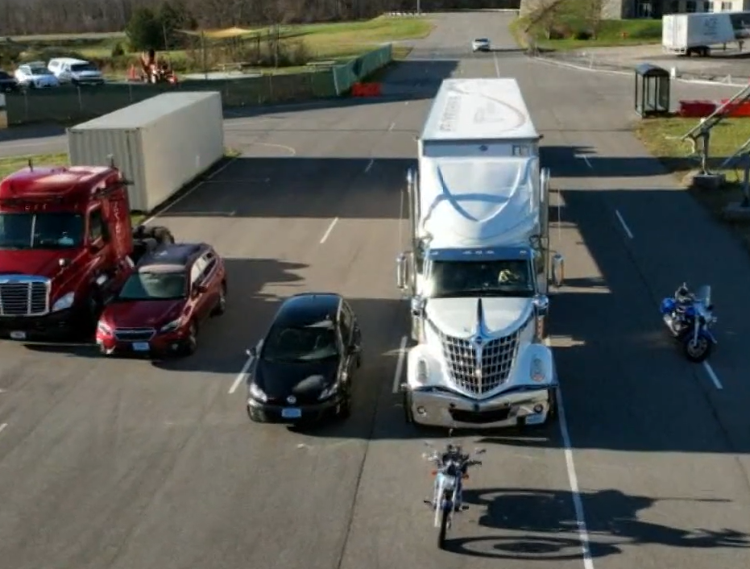
Notes:
There are actually SEVEN vehicles around the CMV. The driver cannot see any of them because they are in the truck’s blind zones.
Show linked video: https://www.whas11.com/video/news/nation-world/how-to-know-if-your-in-a-semi-trucks-blind-spot/417-33499d86-25de-4e89-a36c-c140379fdc47 -Start at 1:17

Slide 9
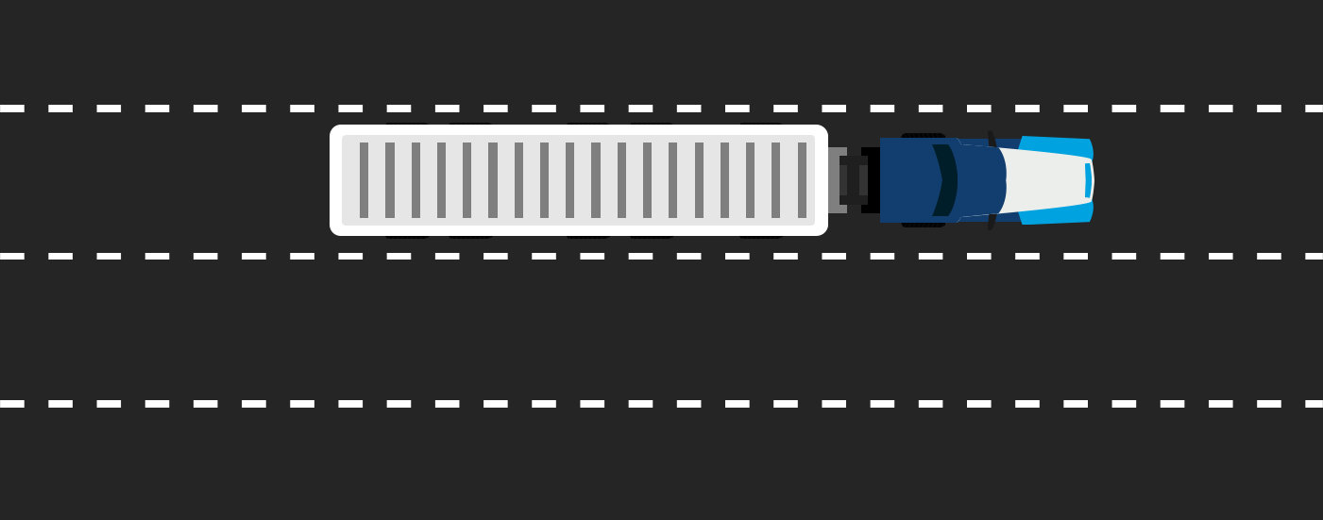
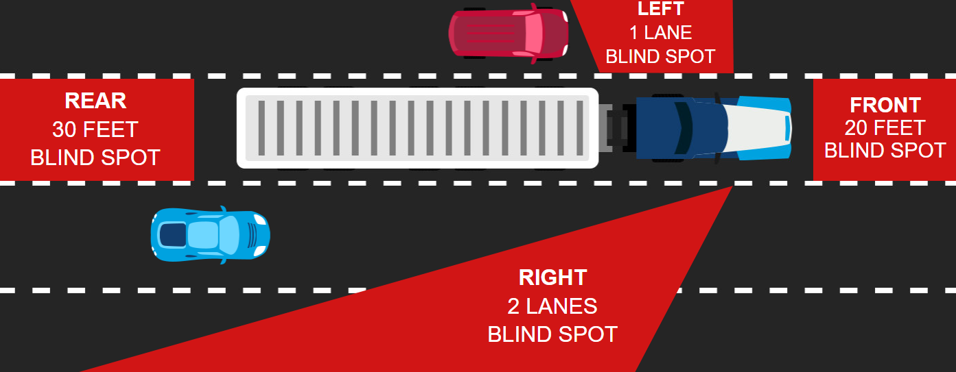
Notes:
Use post it notes to mark where you think it is SAFE to travel alongside large vehicles. After I hit the space bar, compare your post-it note placement to the red blind zones around the truck. Why did you place your post-it notes where you did? Why would you or would you not need to adjust them?
Many people think that because truck drivers ride much higher than other drivers that they can see better. Because of their large size, however, truck drivers have larger blind spots, called “no zones,” than do passenger car drivers. The no-zone represents danger areas around trucks where crashes are most likely to occur.
Side no-zones
Large vehicles have no-zones on both sides. Trucks have larger blind spots on their right side starting behind the cab and extending up to the length of the truck. If you cannot see the driver’s face in the side view mirror, s/he cannot see you. Avoid driving alongside a large vehicle for any longer than required. If the large vehicle needs to swerve or change lanes, the chances of a collision are greatly increased.
Front no-zones
Drivers in truck cabs with long hoods cannot see up to 20 feet in front of their bumper. This is enough room for a car to slip into a position of danger and be completely unnoticed by the driver. Even truck cabs with no hood, called cab-overs, can have a front blind spot up to 10 feet long. Large vehicles take longer to stop than cars; therefore, it is essential not to enter a roadway in front of a large vehicle or change lanes in front of a large vehicle.
Rear no-zones
Unlike cars, large vehicles have a huge blind spot directly behind them that extends up to 200 feet. If you are too close, the large vehicle cannot see your car, and you cannot see what is ahead of you. Avoid following the vehicle too closely and position your vehicle so the driver can see it in his/her side mirrors.

Slide 10
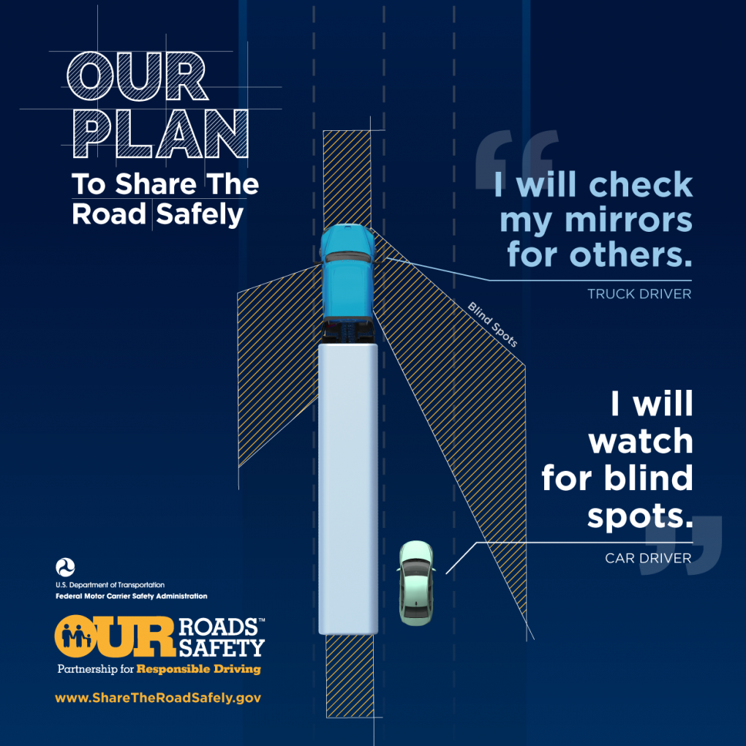

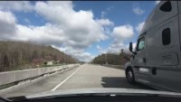
Notes:
Both large vehicles and passenger vehicles need to do their part to safely share the road with each other.

Slide 11
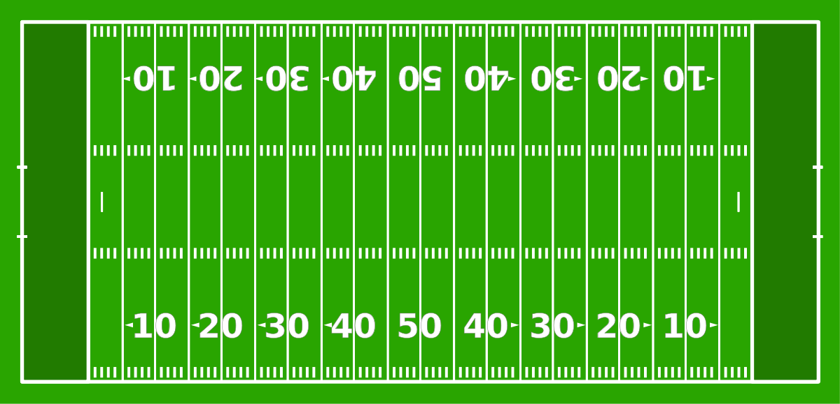
How does this image relate to sharing the road with large vehicles?

Slide 12
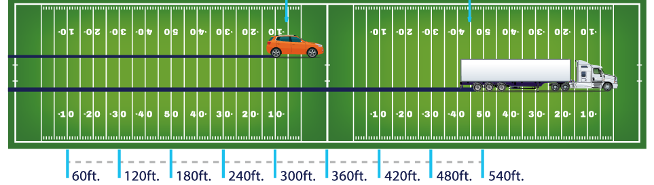
STOPPING TIME & DISTANCE
BRAKE LAG: large vehicles have different braking systems than passenger vehicles. They use air brakes, which include some lag time.
At a speed of 65mph, it can take a large vehicle
two football fields to come to a complete stop.
Notes:
Think of it like this: when you first turn on your garden house, the water doesn’t immediately come out the nozzle. You have to wait for the water to travel the length of the hose before it comes out the end. This is the same concept as air brakes. When the truck driver hits the brake, air builds up, begins reaching everywhere on the truck, and THEN the brakes are applied.

Slide 13
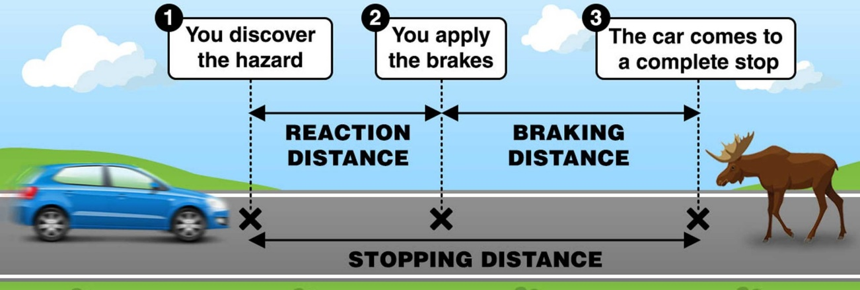
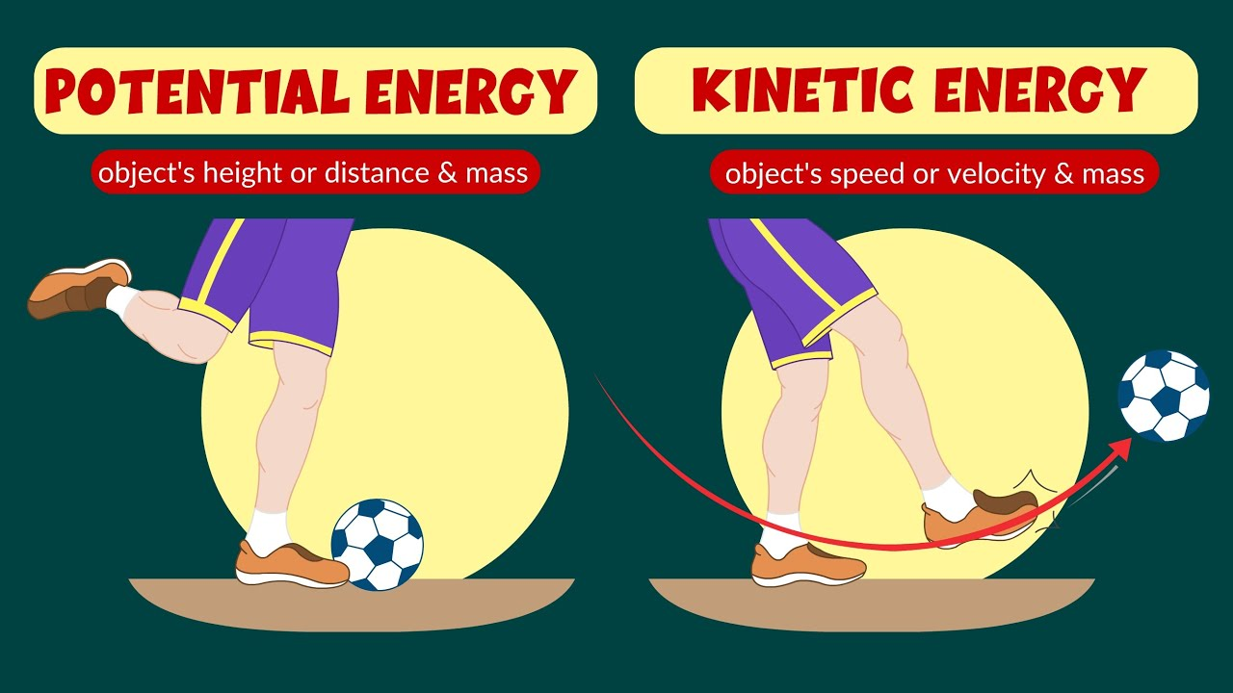
Factors that impact stopping distance
Perception: distance traveled while processing what’s happening
Reaction: distance traveled before foot hits the break
Brake: distance traveled before the vehicle comes to a complete stop
Notes:
Potential energy is stored in an object based on its position.
Kinetic energy is the energy of motion.
Energy can change between potential and kinetic based on an object's motion.

Slide 15
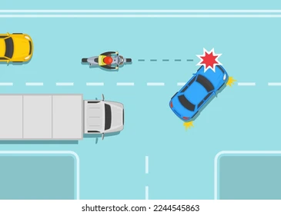
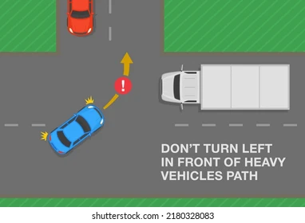
TURNING IN FRONT OF LARGE VEHICLES
Large vehicle collisions are often caused by drivers who underestimate the speed of an oncoming truck.
Notes:
When in doubt about the speed of an oncoming truck, do not turn left in its path or drive toward it in an attempt to pass another vehicle. The truck may be going faster than you think.
Air brakes take longer to engage, adding to the stopping distance. Do not cut off a large vehicle in traffic or on the highway. The few seconds that might be saved are not worth a life.

Slide 16
TRAVELING BEHIND LARGE VEHICLES
Following too closely limits your field of view | Be visible in the mirrors of the large vehicle | Leave 1 car length when you stop
Underride crashes | Debris from the truck | Road clearance
Notes:
One of the biggest problems resulting from tailgating a large vehicle is sight distance. If you follows too closely, the truck’s size will almost prevent you from viewing the road ahead. You will be forced to depend on the truck’s brake lights for a signal that something is going on in the front.
Avoid following too closely and position the vehicle so the truck driver can see the car in his or her side mirrors.
When coming to a stop behind a truck, always leave plenty of room between your vehicle and the truck. Also, move your vehicle to the left of your lane so that the driver can see you in his/her left side mirror. Being too close to the rear of a large vehicle when it is stopped can contribute to a rollback collision. This type of collision generally occurs when a truck driver is forced to stop on an upgrade. As the driver takes his/her foot off the brake and engages the clutch, the truck may roll backwards a few feet striking the vehicle to the rear.
Another extreme hazard for passenger car drivers is striking the back of a large truck. This type of collision is known as an “underride.” Underride is generally defined as a type of collision in which a portion of a passenger vehicle slides under another vehicle. Underrides can occur between two passenger vehicles but are more common and more dangerous between a large truck and a passenger vehicle. Following large vehicles too closely can place a motorist in danger if debris should fall from the truck. Tires can blowout. Cargo, large pieces of metal, spare tires, etc., can all fall off a large truck causing considerable damage to any vehicle following too close. In some cases, debris falling from large vehicles has caused some drivers to the rear to become seriously injured or killed.
The road clearance of large vehicles is high enough to straddle road debris (blown tires, wood, dead animals) and unfortunately most of today’s vehicles will not have the ability to avoid this debris if they are following too closely.

Slide 17
Solve the Problem:
Every year there are thousands of crashes involving heavy vehicles & buses on Washington roads. Many of these accidents involve a large vehicle rear-ending the person in front of them or being rear-ended by the person behind them.
What can passenger vehicles do to reduce these kinds of crashes? Be specific with driver behaviors and details that would assist drivers of large vehicles.
Notes:
Present students with (a) scenario(s) that led to the creation of the Move Over Slow Down law and have them discuss solutions in pairs/small groups how they would propose solving the issue. (Instructors could easily sub this scenario with tow truck drivers or other emergency/utility workers.) Allow students 3-5 minutes to brainstorm what steps should be taken to protect officers, emergency personnel, roadside workers. Challenge them to be specific with what speed and/or distance feels reasonable to them. Listen to their discussions and use them to segue into the actual parameters of the law.

Slide 18
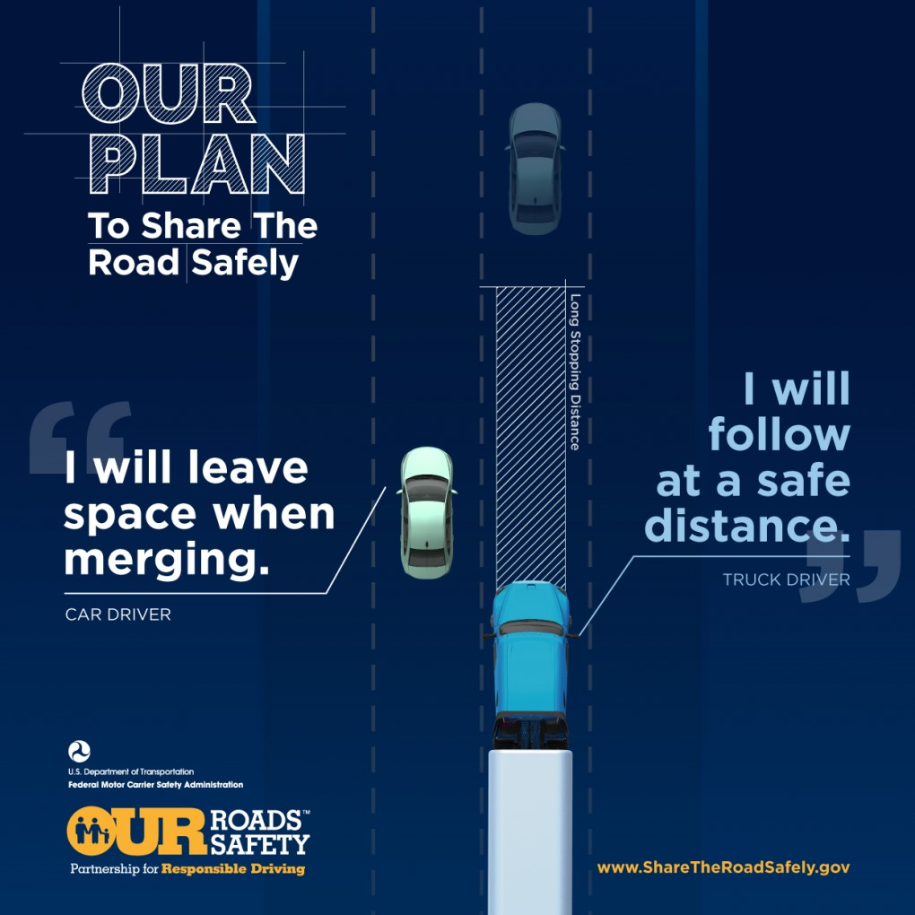
Everyone must do their part to safely share the road with each other.
Notes:
Creating safe roads is every driver’s job. Large vehicle drivers rely on you to follow the law (speed limits, turn signal usage, lane use, passing). YOU can help THEM predict what drivers are going to do and adjust accordingly.

Slide 19
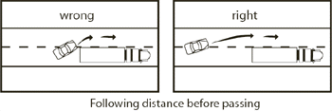
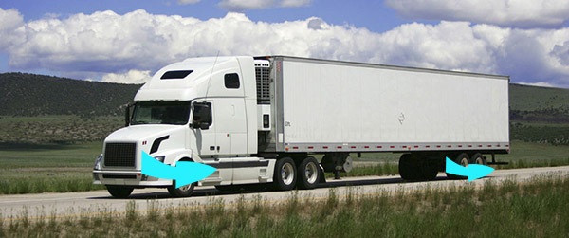
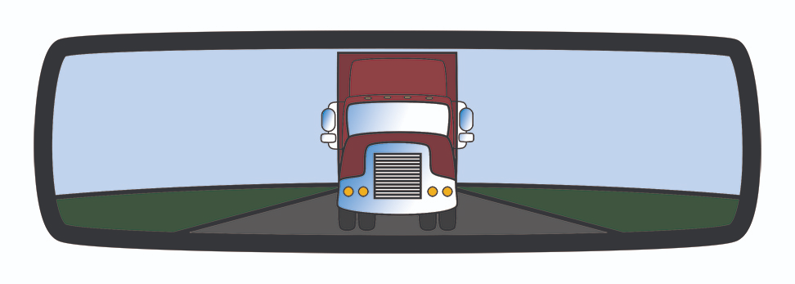
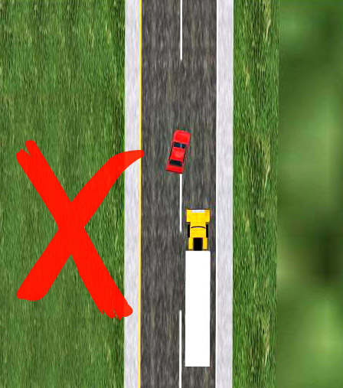
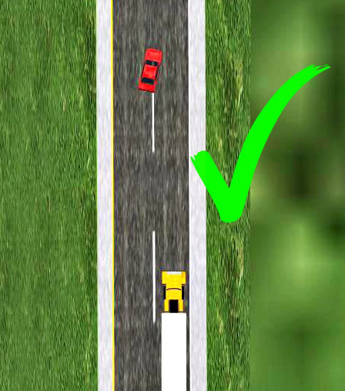
PASSING
Pass from where the truck driver can see you, not from directly behind the truck.
You may need to accelerate a bit while passing. Do not linger in blind zones.
Keep a firm grip on the steering wheel. Stay mindful of turbulence from large vehicles.
Do not cut in front too soon after passing.
Return to the lane once you can see both headlights in your rearview mirror.
Do not slow down once you’ve passed the truck. Maintain speed and make sure there is a safe space between you and the truck.

Slide 20
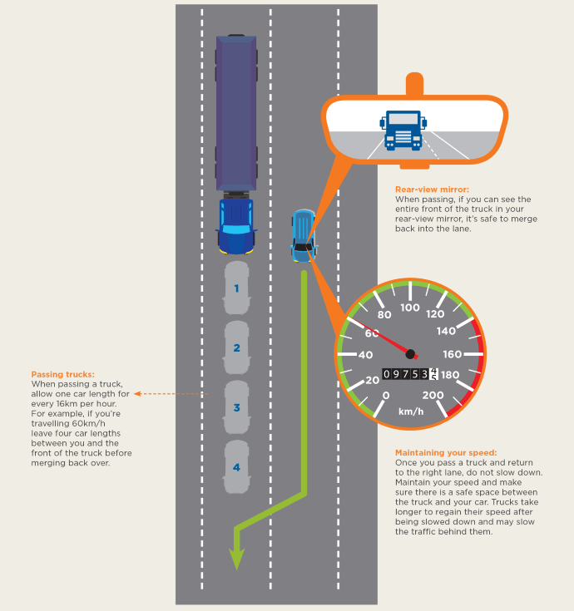
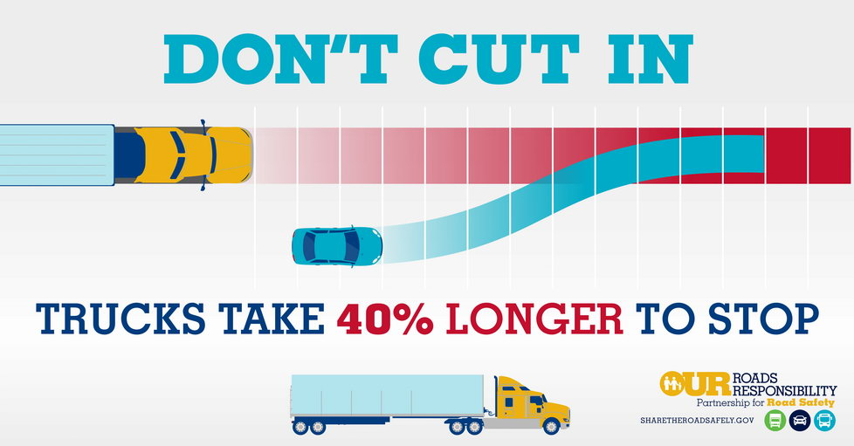
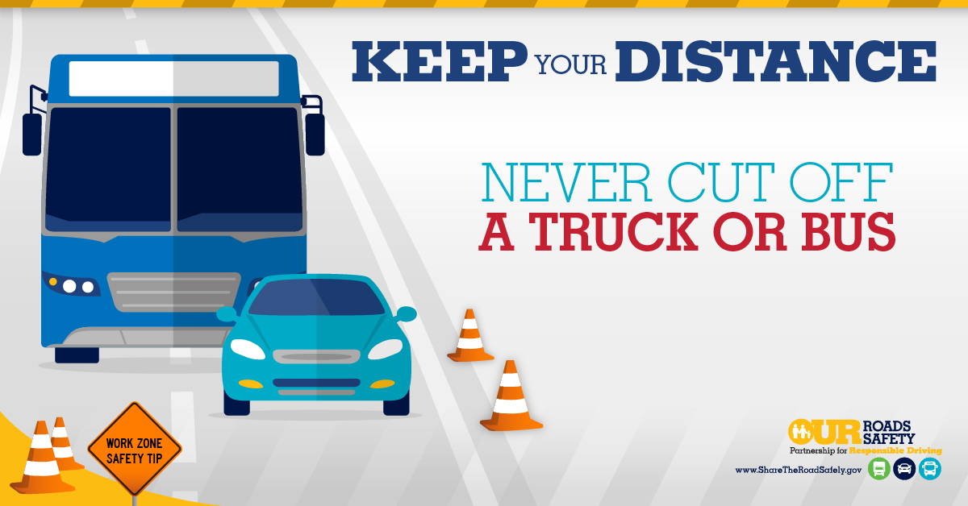

Slide 21
WIND TURBULENCE
Because of their size, large vehicles can create turbulence, which is wind that can affect the stability of vehicles nearby. Turbulence can affect your vehicle’s stability.
When passing large vehicles hold the steering wheel firmly and allow for plenty of space.

Slide 22
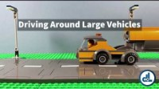

Slide 23
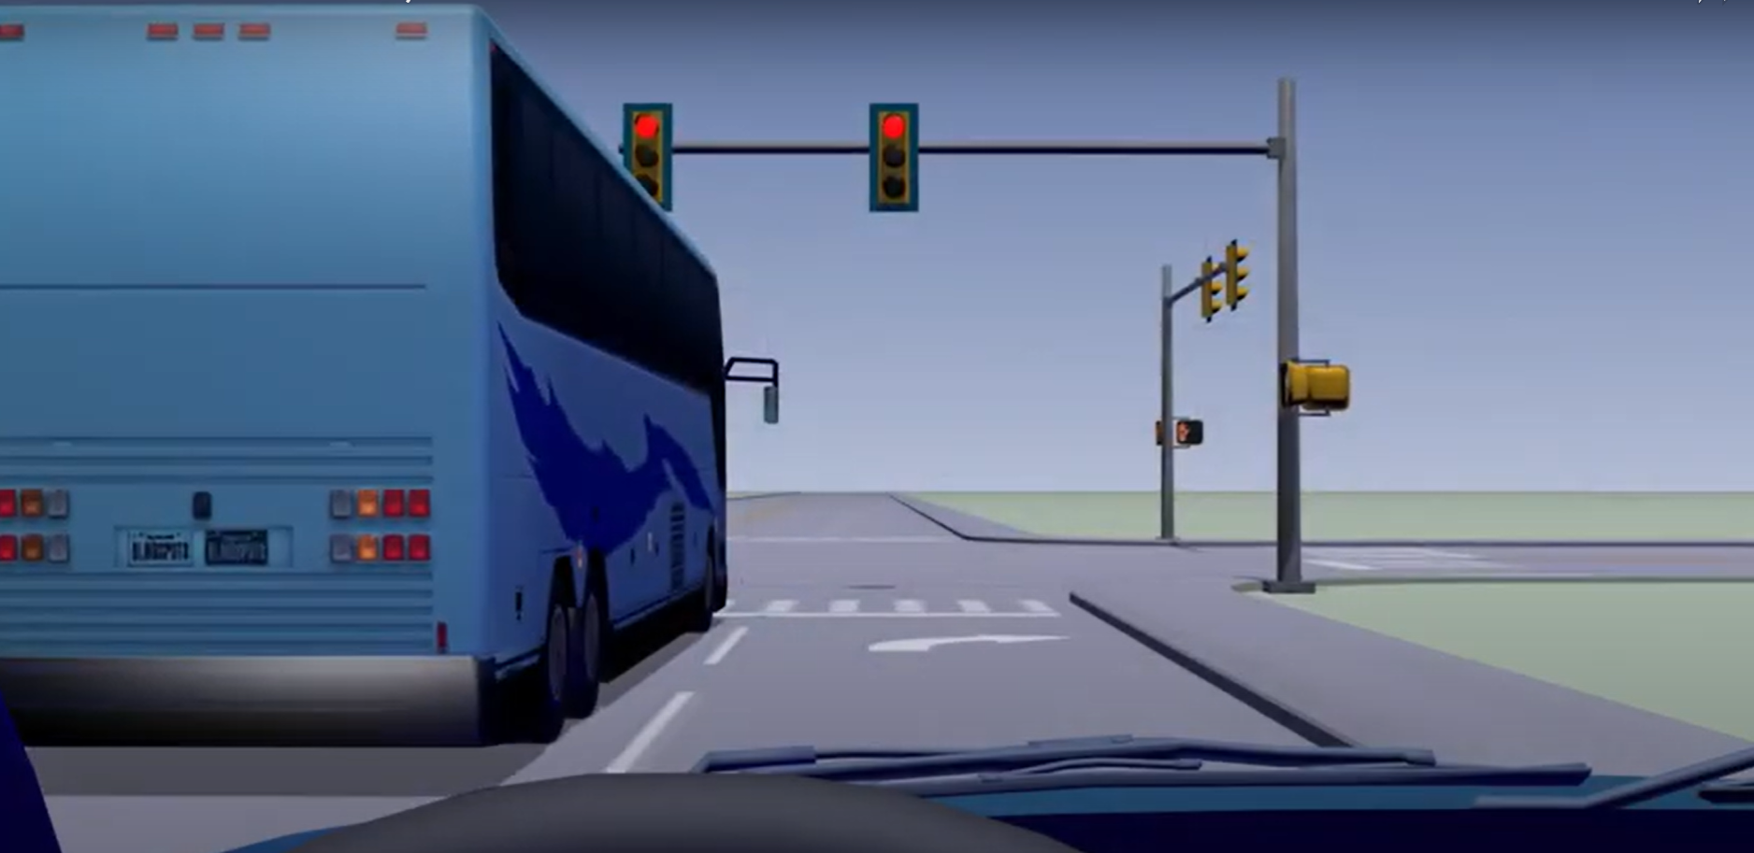
TURNING
Notes:
Both of these lanes are right-turn only. That means the bus and the (POV) driver will be making a right turn at the light. Ask students what they should consider in this scenario. Ask them what they would do.

Slide 24
Give them space to turn

Slide 25
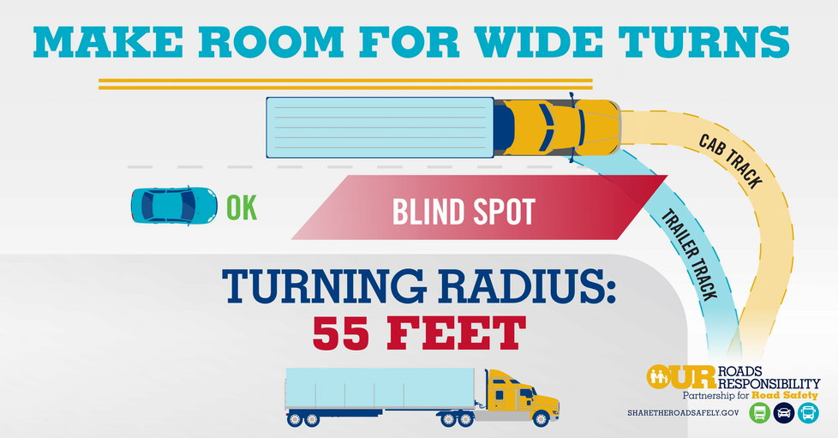
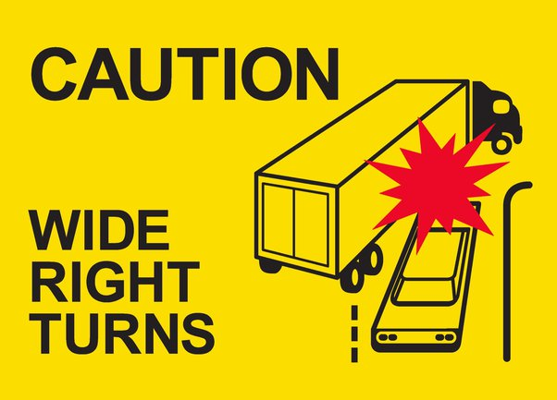
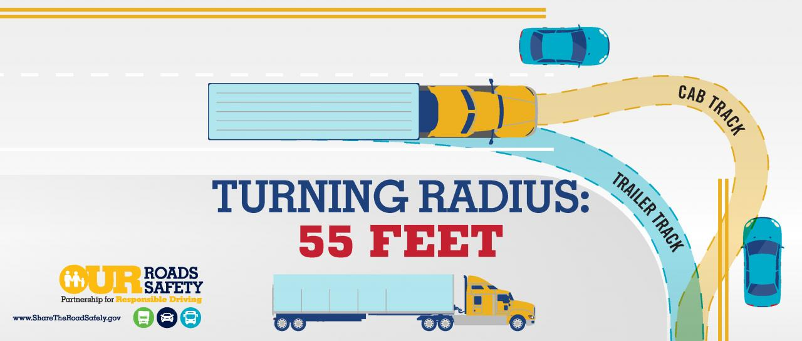
anticipate wide turns: Buses and trucks swing wide and sometimes start a turn from the middle lane. Do not try to “squeeze by” a turning truck or bus.
Notes:
Use all the arrows to point out all the ways vehicles around a semi-truck or bus might have to adjust for a turn. Left-turning drivers will first swing wide to the right, and right-turning drivers will first swing wide to the left, to enter a cross street. The sharper the turn, the narrower the intersection, and the longer the truck, the wider the driver must go. Off-tracking can force a truck’s trailer to cut off or “squeeze” roadway users to the sides. Many drivers following a tractor semi-trailer assume that if the truck moves to the left it is preparing to make a left turn. However, drivers of large trucks usually swing out to the left as the first step in making a right turn.
If a truck is stopped at or approaching an intersection, never attempt to “cut in” along the right side of the roadway as the driver first maneuvers left, or you will find yourself sandwiched between the turning truck and the curb.
Trying to pass a right-turning truck driver on the left can also present dangers. If the truck swings wide enough, it can force you to stray into oncoming traffic or the median of the cross street.
Always give a truck driver sufficient clearance and time to complete a turn safely. Many intersections are marked with stop-lines indicating where a driver must come to a complete stop. Stop-lines are designed to set motorists farther back at an intersection in order to give larger vehicles more turning space. These are called staggered stops.

Slide 26
Be mindful of large vehicles turning.

Slide 27
Special Situations

Slide 28
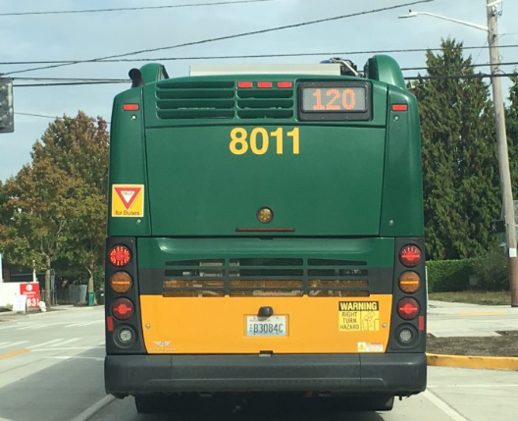
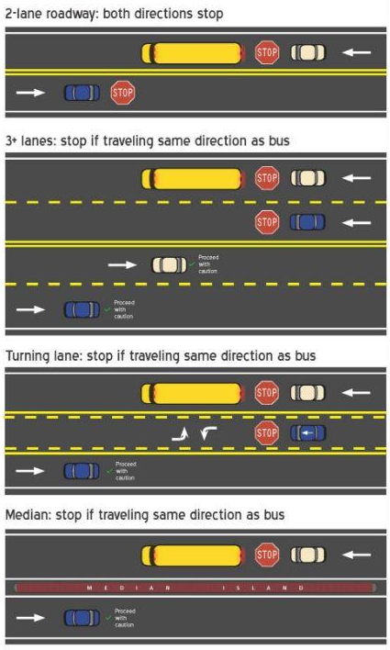


Transit buses
The rules for sharing the road with transit buses are DIFFERENT than the rules for school buses.
A vehicle must yield the right-of-way to any public transit vehicle that has signaled and is attempting to re-enter traffic traveling in the same direction.
Notes:
School bus infographic for comparison purposes only. A separate lesson should be given on school bus/school zone safety specifically.

Slide 29


Merging onto the freeway
Notes:
On the left: merge onto the free AT THE SPEED LIMIT. Do not merge in front of a semi truck going 40mph if the cards on the road are going 60.
On the right: slow down and let the truck pass. Ideally you saw this potential situation soon enough that you began slowing down well before entering the freeway.

Slide 30

HAZARDOUS MATERIALS
Recognize when a vehicle is carrying dangerous cargo and execute maneuvers with extra care and caution.
Unexpected or unsafe actions may cause the truck driver to take evasive actions.
Crashes with hazardous materials can endanger not only the drivers on the highway, but can affect people, animals and the environment in areas surrounding the crash.

Slide 31




WIND & WEATHER
Notes:
Severe wind conditions can have a dramatic effect on large vehicles/trucks and trailers. Be aware and execute extra care in these situations.

Slide 32





Notes:
Considerations for large vehicles in adverse weather: transit bus in rain, snow plow at work, semi truck in freezing temp and sunshine, de-icing machines/sanding trucks in snow.

Slide 33
Review

Slide 34

1. Pass Safely: ensure the truck/bus lights are both visible before pulling in front.
3. Don’t Cut it Close: long stopping distance may prevent the driver from stopping in time.
6. Stay Back: tailgating a truck puts you in their blind spot. If you fail to stop in time, your vehicle could slide under the truck. Keep a safe distance when stopped (esp on a hill)
7. Be patient: trucks and busses accelerate slowly
8. Stay Out of Blind Spots: If you can’t see the driver in the vehicle’s side mirror, assume they can’t see you.

Slide 35







1
2
3
4
7
6
5
Notes:
Either go in order or ask students to identify what the issue was/could be in each image.
Tailgating/Speed
In truck’s blind zone
Trying to pass the truck in a turn
Tailgating a bus/Speed
“shooting the gap”
Trying to pass/shoot the gap
Driving in a blind zone

Slide 36

Self-Reflection Questions
List five behaviors you must have to help create a safe driving environment with large vehicles.
What should you do to avoid traveling in a large vehicle’s blind zone?
When traveling behind a large vehicle, why do you want to stay back?

Slide 37
Sharing the road with large trucks
Of the following, which is NOT a factor in stopping distance?
Perception
Reaction
Brake
Road Surface
Vehicle Size
Speed
Time of Day
When you’re driving along side large vehicles, what should you do to help them see you better?
Honk
Flash Your Lights
Stay Out of Their Blind Zones
Turn on Your Brights
Why do trucks require special awareness when turning a corner?
They may need to use more space than their lane provides
They can’t see where they are going
You can easily be rear-ended when they turn
Notes:
Once projected, click the spacebar to circle answers.

