Slide 1
Department of Licensing
Certified Examiner Training

Slide 2
Module 1 Introduction & Training Purpose/Steps
Certified Examiner Training

Slide 3
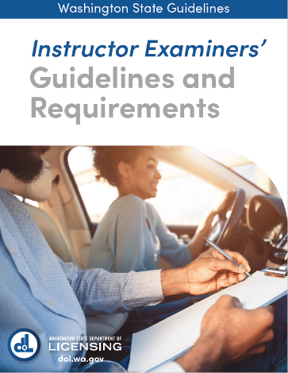
Purpose
This course provides participants with knowledge and skills to conduct drive tests. This course is designed to help participants prepare for drive test certification.
This course will focus on material covered in the Instructor Examiners’ Guidelines and Requirements 2021.

Slide 4
Why we need Certified Examiners:
For the public:
Applicants can quickly and conveniently receive a knowledge/drive exam
For our schools:
Approval from DOL to administer DOL required tests
For reliability:
Gain the skills and knowledge to reliably administer a knowledge/skills test
For validity:
Assure eligibility for licensing from all applicants
For our community
Ensure that drivers demonstrate knowledge and skills to safely operate a motor vehicle
For our future
Contribute to our state’s Target Zero goals

Slide 5
Certified Examiner Training
Includes:
DOL-approved 18-hour training, taught by a DOL-endorsed Master Examiner (ME)
The training certifies Instructors to administer the Knowledge & Skills Tests
The 18-hour training should meet the same standard of training as is required by DOL for its own employees & should be delivered as DOL prescribes
Following completion of the training, Certified Examiners (CE’s) must show the ability to properly administer the Knowledge & Skills Tests and meet DOL testing standards

Slide 6
Training Hours (Homework)
Prior to the Classroom Component (4-hrs.):
Complete the DOL Examiner Training Tutorials online
Pass the tutorial quizzes with scores of 100%
Read the current Instructor Examiners’ Guidelines & Requirements Manual (IEGR) 2021

Slide 7
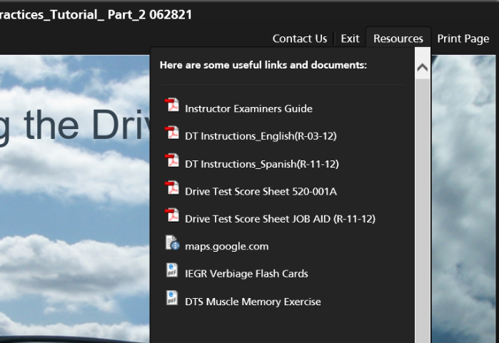
New Pre-CE Course Tips Offered in Tutorials
Verbiage Flash Cards
Map Footprint Exercise
Notes:
These can be found within the Resources tab of Part 2 of the Instructor Examiner Best Practices Tutorials. Also, they are in the CE training binder.

Slide 8
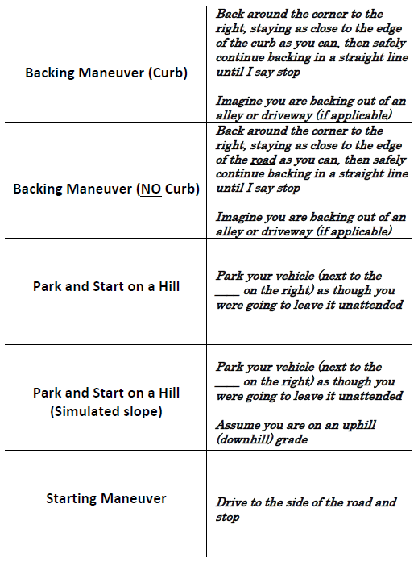
Verbiage: MEMORIZE
Notes:
One of most critical things you can do to prepare for your Certified Examiner Course is memorize the required exact Skill Exam verbiage before your CE Training. Doing this will:
---
Allow you to focus on identifying errors and not whether the verbiage is incorrect during the BTW portion of your training.
---
Memorizing verbiage will also increase the overall likelihood of first time passing of your initial certifying Check-ride.
---
Depending on the size of your class, the behind the wheel portion of your CE training may only consist of 4 practice scoring drives with 8 observation drives in the back seat. Spend this time focusing on discovering errors and not being frustrated trying to remember the verbiage!
Depending on the size of your class, the behind the wheel portion of your CE training may only consist of 4 practice scoring drives with 8 observation drives in the back seat. Spend this time focusing on discovering errors and not being frustrated trying to remember the verbiage!
---
Everyone remembers things differently, use whatever memorization technique that works best for you! Some remember things by typing or writing phrases multiple times and others find that using flash cards work best to continually quiz oneself.

Slide 9
Understanding the “Footprint” of the Score Sheet
MANEUVERS-
You will NEVER reference
these until the maneuver.
Don’t get “lost” looking for
an error in this part of
the score sheet unless a
maneuver is being performed
Majority of traveling errors
will occur in these area
Majority of traveling errors
will occur in these area
Notes:
Knowing the footprint or the layout of the Drive Test Score Sheet and understanding where, or just as importantly, where not the error is listed will be a critical piece of your training!
---
Let’s take a look to see if we can break the Drive Test Score Sheet down into quadrants that make it easier to find what we are looking for.
Quadrant one on the upper left hand side list all the maneuver areas.
--
Quadrant two and three indicate where most of the primary driving errors occur while traveling between maneuvers.
--
While as important to identify, quadrant four, contains some of the less frequent occurring, secondary errors that occur while traveling between maneuvers.
--
Maneuvers- You will NEVER reference this portion of the score sheet until the maneuver. Don’t get “lost” looking for an error in this part of the Drive sheet if you are traveling between maneuvers.
--
Remember, as the certified examiner YOU control when the applicant leaves the maneuver; this should give you ample time to find the appropriate errors before continuing. There should be no reason to look at this quadrant of the score sheet while the vehicle is on the road in motion, less exiting the maneuver.
--
The remaining areas of the drive test score sheet indicate errors that typically occur while traveling between maneuvers. Statistically, a majority of the non-maneuver related errors occur here.
Understanding where on the Driving test score sheet that the errors are listed, is critical in becoming a certified examiner; the use of muscle memory techniques can help greatly while you start your training.

Slide 10
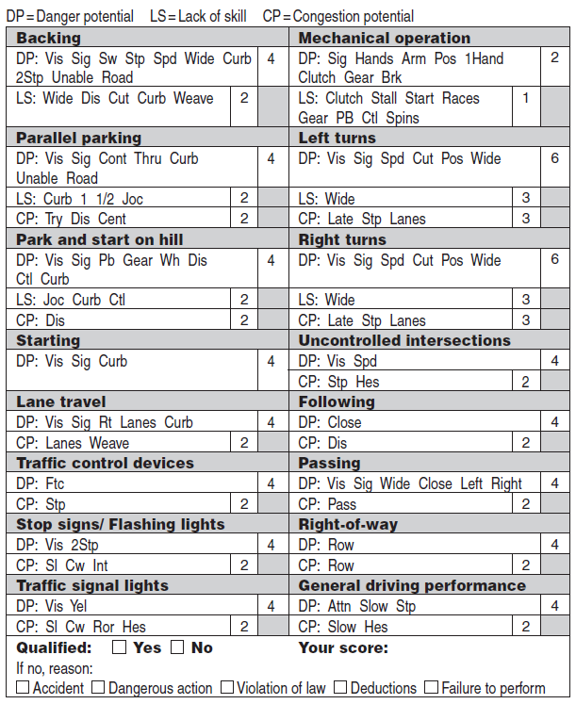
Understanding the “Footprint” of the Score Sheet
Notes:
Understanding where on the Driving test score sheet that the errors are listed, is critical in becoming a certified examiner; the use of muscle memory techniques can help greatly while you start your training.
--
Muscle memory is defined as the ability to reproduce a particular movement without conscious thought, acquired as a result of frequent repetition of that movement.
--
Go to the resource tab and print off a copy of both the Driving Test Scoresheet and the DTS Muscle Memory Exercise to use a simple method to building that mental site picture of the score sheet.
--
While looking at the DTS muscle memory exercise sheet, select a non-maneuver category in your mind.
--
Without looking at the score sheet, place your finger, pencil or pen where you think that category is located. Now look down at the Driving test score sheet:
--
Are you in the same quadrant?
--
Are you right on? Repeat this multiple times until it becomes second nature as to where each category is.
--
Remember, the more time you spend searching for where to score, the less time you are watching the road / applicant!
--
Understanding quickly where an error should be marked, along with having the exact verbiage prior to the start of your Certified Examiner course will boost your confidence and make your initial training much less stressful!

Slide 11
Training Hours (Classroom)
Classroom Components include (6 hrs):
Introduction, overview, and read the CE Training Expectations letter to the students
Sign an attendance roster each day
Instructor reads the welcome and purpose of training letter titled Certified Examiner Training Expectations
Provide training following the DOL Examiner Training Power Point, using a projector screen that all in the class can see, and each student be provided an Instructor Examiners’ Guidelines and Requirements manual with associated training materials in hard copy form
Complete and review in class, the scoring worksheet

Slide 12
Training Hours (In-vehicle)
In-vehicle Practice & Observation (8-hrs,), each drive consists of:
In-vehicle examiners’ practice
Vehicle Inspection & applicant checks (brake reactions, etc)
In-vehicle practice scoring drives – a minimum of 4
Verbiage
Observations
Minimum of eight (8) skills test observations
Final Practice Drive (if needed)
Used as an overall assessment for trainees who appear to need additional training

Slide 13
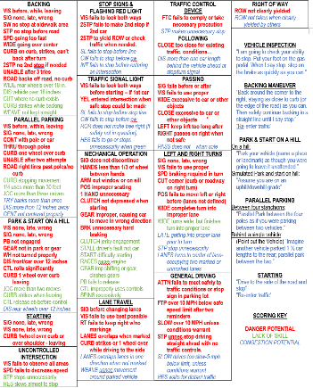
In-Vehicle: Practice scoring drives (4 Minimum)
Trainee must complete a minimum of four (4) practice scoring drives as the examiner
Master Examiner drives, acting as the mock applicant for trainees
Trainee acts as Examiner scoring from the front seat
Trainee gives Master Examiner practice drive results after the drive is over
Post-drive feedback (while in vehicle) is provided after each mock drive test. This includes, answering scoring questions after each maneuver is permitted. By the last drive, the candidates should be able to complete the scoring without assistance
May use training tools such as the verbiage script sheet or scoring job aid (See Appendix 9 – Drive Test Scoring Job Aid in IEGR).
Notes:
Review Job Aid

Slide 14
In-Vehicle: Observations (8 minimum)
Trainee must complete a minimum of eight (8) skill test observations (scoring from the back seat)
Trainee observes practice scoring drives from back seat while filling out a score sheet
If there are not enough trainees, you can use additional practice scoring drives as a substitute for the required observations
Trainee gives post drive feedback about the observation to the Master Examiner

Slide 15
Training Guidelines
Specific Training Guidelines
Complete training within 3 days
Training has to be given in subsequent or adjacent days
No late enrollees or partial credit
Must complete all components of training in set time
Send DOL – DTS Program all training documentation

Slide 16
Post Training Check-ride
The check-ride must occur no sooner than 7 days, and no later than 45 days, after completion of the Certified Examiner training course
The Certification Check-ride is conducted by the certifying Examiner and administered to a DOL-endorsed ME (as a mock customer) for the purposes of demonstrating the ability to properly administer a Skills Test

Slide 17
Check-ride Requirements
Reasons for Disqualifying a Check-ride
If the Master Examiner scored the drive as a failing score while the certifying examiner scored the drive as a passing score
Does not perform equipment check, brake reaction test, or hand signals
Failure to perform one or more of the maneuvers, complete the route, or fails to complete the entire maneuver
Coaching, bribery, and inappropriate behavior
Poor awareness
Not using verbiage verbatim
Scoring Errors:
Failure to add the total score correctly
Failure to score 3 or more Danger Potential deductions
Missing 30% or more of the total deductions (under scoring)
Not recording deductions (mental scoring)
Lack of knowledge on where to put the errors
Not scoring repeat errors (using hash marks)
Over-grading (scoring errors that are not errors)

Slide 18
Check-ride Requirements
Guidelines
If an instructor fails three certification check-rides, then they do not qualify for certification as a Certified Examiner
If an instructor fails to qualify for certification, they will not be permitted to administer any skills examinations for six months from the date they failed their third certification check-ride
An instructor that fails to qualify for certification may elect to become a Certified Knowledge Examiner during the six-month waiting period
After six months, instructors may make another attempt to become a Certified Examiner, if they:
Meet the qualifications to become a Certified Examiner
Re-take the 18-hour Certified Examiner training
Successfully pass a Certification Check-ride without the use of job aids

Slide 19
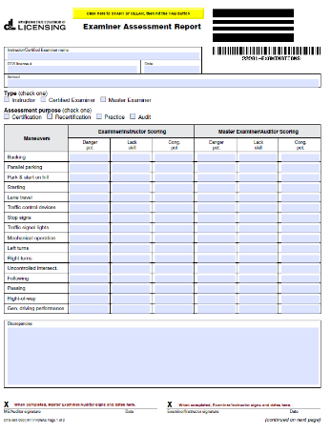
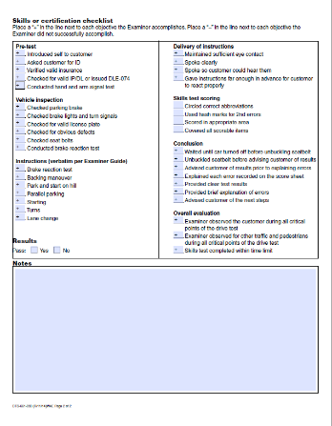
Processing a Check-ride
The certifying Examiner must exhibit all the primary requirements listed on the Certification Checklist, in order to be certified.
Following the Certification Check-ride, the Master Examiner (ME) must complete the Examiner Assessment Report (EAR) & send it to DOL for review and status processing.

Slide 20
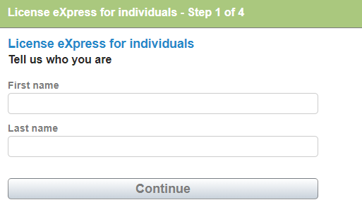
Drive Test Check-in
Check applicants DOL number through License Express
(If they don’t have one, send them online to pre-apply @ https://secure.dol.wa.gov/home/newDriver.aspx)
Check if they are flagged to test at LSO, if this is the case refer them to nearest LSO office
Check valid knowledge test PASS score within the last 2 years
Check route (always using next alternating routes)
Check valid course completion if under 18 years old
Check name/birth date is correct in License Express (refer the applicant to call LSO customer service if this is incorrect)

Slide 21
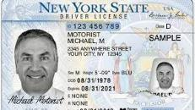
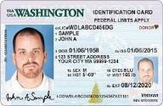
Identification
Something that associates the person taking the exam to a name, date of birth, or identifying photo and/or signature.
Note: Only original or certified copies of authentic documents from issuing authorities are accepted for evidence of identification.
Typical documents include (expired less than 6 years and you can still identify the applicant):
WADL, WAID, WAIP (with photo)
Out of state DL, ID, or IP (list the state)
US or foreign passport (list the country)
Other US government issued documents: Tribal ID with photo, residency card, police identification
Alternate documentation:
School ASB card with photo with a date of birth document (birth certificate or non-photo WAIP)
Foreign ID Cards (check google images in verification if unsure)
School yearbook photo with a date of birth document (birth certificate or non-photo WAIP)
Check IEGR 3.2 Eligibility for examinations
NOT ACCEPTABLE: Costco cards, photocopies, personal mail, international drivers licenses, etc
Notes:
Note: Only original or certified copies of authentic documents from issuing authorities are accepted for evidence of identification.

Slide 22
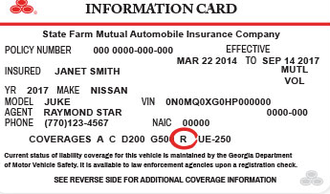
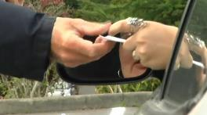
Insurance
Includes:
Name of the policy holder, description of the vehicle, effective date of coverage and expiration date and policy number. (List both effective & expiration)
SR22 or Broadform are acceptable
Insurance may be presented in an electronic form
Rental cars are only acceptable if the person is a licensed driver (i.e. from another country)
The customers ID and insurance must be inside the vehicle while testing.

Slide 23
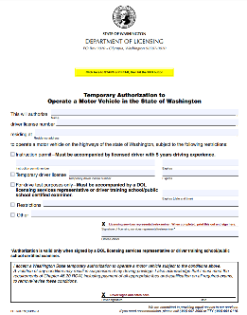
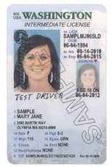
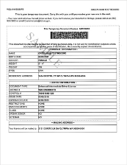
Instruction Permit
All applicants must have a valid instruction permit, or a valid foreign driver license prior to taking the drive test.
Verify that the applicant has one of the following:
a valid instruction permit
or
a valid foreign driver license
or
a valid Temporary Authorization to Drive (TAD)
NOTE: Hole punched or expired WAIP are valid for test but must be used along with a
Temporary Authorization to Drive (TAD)
Notes:
Review Temporary Authorization to Drive

Slide 24
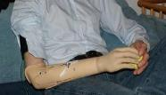
Physical/Mental Assessment
Do not test if applicant has any sort of physical, visual or mental impairment. Refer to LSO.
Limited strength or mobility
Artificial limbs/loss of limbs
Paralysis
Severe tremors
Temporary impairments
Mental limitations
Casts
Crutches
Braces
Limited neck mobility that would inhibit them from checking over their shoulder
Deaf or hard of hearing applicants CAN test at a school and they may bring a State-certified interpreter, (sit behind the tester) if the applicant can read lips, they don’t have to use an interpreter.

Slide 25
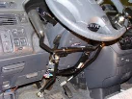
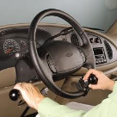
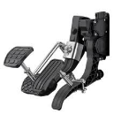
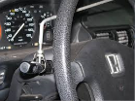
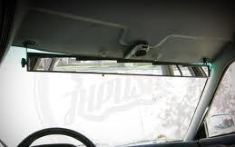
Pre-test
If the applicant brings their own vehicle for the Skills Test, check for any extra vehicle equipment that the applicant may be using to compensate for an impairment. These may include:
Pedal extenders
Steering knob
Turn signal extensions
All hand controls
Panoramic mirror

Slide 26
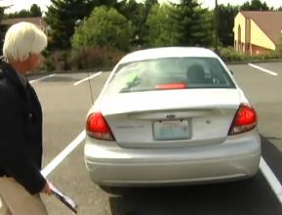
Pre-trip Inspection
Check parking brake
If engaged have them disengage and re-engage
Make sure the driver’s side window rolls down
Passengers’ door must open and close from inside and outside
Left outside mirror is always required. Right outside mirror is not required by law. If there is no rearview mirror, then a right outside mirror is required

Slide 27
Pre-trip Inspection (cont.)
Stand to the side of the vehicle check the lights
Brake lights (center if it’s equipped)
Turn signals
If not working let the applicant know that hand signals must be used properly throughout the entire test or let them know that they can use different vehicle or re-schedule
Cannot be done if it’s dark, must reschedule or use different vehicle
License plates are required on the front and back
If there are indentations/holes for a front license plate, the plate must be in place
Check tabs
If they expire during the same month check the registration
Misc.
Windshield wipers when raining
Headlights when dark, raining, or other conditions warrant
Studded or winter tires when snow and ice are on the roadways
If IID is required, they must do the test in that vehicle
NOTE: For mechanical issues that prevent completion of the exam do not score or enter the test information into the License Express for Business website. Mechanical issues are viewed as an equipment failure.
Notes:
NOTE: For mechanical issues that prevent completion of the exam do not score or enter the test information into the License Express for Business website. Mechanical issues are viewed as an equipment failure.

Slide 28
Module 2 Instructions to the Applicant
Certified Examiner Training

Slide 29
Introductions
Introduce yourself
Did they read the test appointment brochure and have any questions?
Ensure applicant has signed school’s exam policy, TAD (if no valid permit), and score sheet
Seatbelts must be always worn during the test
If they take off their seatbelt at anytime throughout the test, instruct them to put it back on and continue the test

Slide 30
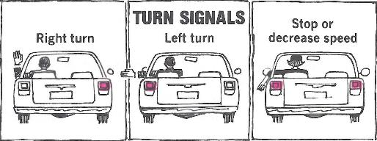
Hand Signals
Occasionally alternate the order in which you give the hand signals
If they do not know the hand signals the applicant may be provided a resource for review for a short period of time
Don’t coach or instruct on hand signals
After the hand signals have been demonstrated properly continue with the test uninterrupted

Slide 31
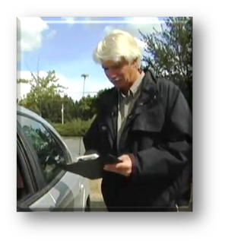
Brake Reaction Test
Stand outside the vehicle
“I am going to check your ability to stop. Put your foot on the gas pedal. When I say stop, step on the brake as quickly as you can.”
Pause briefly, and in a normal tone of voice say, “Stop”
You are checking to make sure the applicant can quickly stop the vehicle in an emergency
Slow reaction times might be an indicator of poor awareness, lack of strength or mobility or mental/physical limitations
If they don’t understand, you may rephrase the instructions to ensure the applicant understood the task, then repeat verbatim

Slide 32
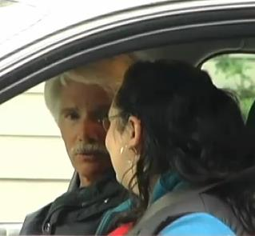
Guidelines for Administering the Drive Test
Examiners must follow the drive test course as outlined and may not omit any part of the test. It is extremely important that instructions be given in a uniform manner. General points to remember are:
Give instructions far enough in advance to make sure the maneuver can be safely completed.
Look at the person and use a normal conversational tone.
Be professional and courteous.
Score as if other traffic is present, whether present or not.

Slide 33
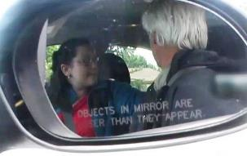
During the Test
Do not hurry the applicant and avoid appearing impatient.
An applicant may decide to stop the drive test. You should not urge them to continue.
If the applicant loses control of the vehicle, you must be alert and prepared to assume control, including verbal or physical control (turning the steering wheel, applying the parking brake, or turning off the engine)
You must be careful to watch everything the applicant does. Do not get into the habit of focusing on scoring only one or two items.
Turn your body towards the applicant slightly this will allow you to be able to see any slight vision checks that you might miss if you were looking straight ahead.
Only the Examiner, the applicant taking the exam and an interpreter for the hard of hearing (if needed), or service animal (if needed) are allowed in the car.
If an IID warning signal sounds during the drive test requiring a breath sample of the driver, instruct the applicant to drive to the side of the road and stop. When the breath sampling is completed, continue with the drive test.

Slide 34
During the Test (cont.)
Don’t rely on memory, score it as you see it
Don’t be TOO quick to assume control, unless it is obvious the customer cannot safely continue the test
Score inconspicuously, but not secretly
Don’t deviate from the manual and put your own interpretations on the test scoring
Use good judgement when scoring. If you didn’t see it, or it is not listed, do not score it
Use the DOL job aid sheet but do not look at the job aid when the vehicle is moving or when providing instructions

Slide 35
Teaching versus Testing
It is not appropriate or permissible to provide training during the drive test. Some examples would include:
Warning applicants about their bad habits
Coaching, prompting, encouraging, using reference signs, or adding unnecessary conversation
Discussing rules of the road with the applicant (i.e. speed limit)
Providing hints or pointers (e.g. “at the stop sign turn left/right;” or “are you sure that’s all?”), or an unnecessary look prior to the applicant looking to check for traffic. (You should verify it is safe to go immediately after the applicant has checked)
Announcing the name of the maneuver or control device (e.g. “Now we’re going to do the backing maneuver” or “at the stop sign turn right” )
Acknowledging correctness once the examination has started (e.g. “Great job” or “You’re doing it right”)

Slide 36
Module 3 Drive Test Score Sheet & Scoring Criteria
Certified Examiner Training

Slide 37
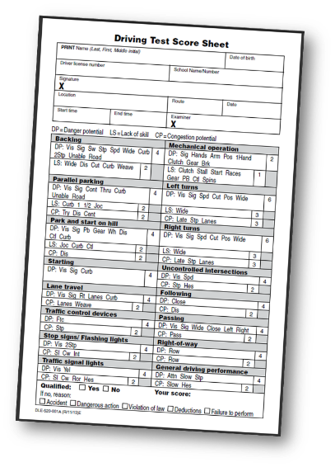
The Driving Test Score Sheet
This score sheet is for testing only.
Keep a copy of the score sheet in the student file.

Slide 38
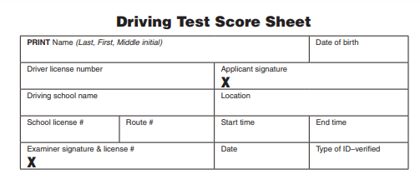
The DT Score Sheet (Continued)
Use the following guidelines to begin filling out the DT Score Sheet:
Name: Print the applicant’s name as shown in your records or on the applicant’s identification or permit
Date of Birth: Print the applicant’s date of birth as shown in your records or as shown on the applicant’s identification or permit
Driver License Number: Copy the applicant’s license number as shown in your records, on the applicant’s receipt, or on the applicant’s identification or permit
Doe, John, R
1/1/11
WDL123456789

Slide 39
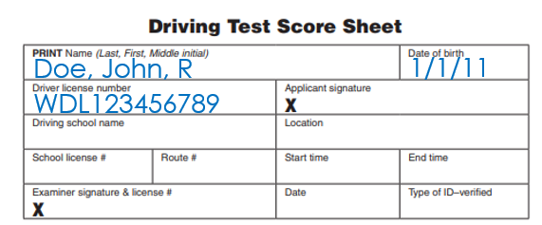
The DT Score Sheet (cont.)
School Name and Number: Enter the school name and number assigned by DOL
Signature: Have the applicant sign the DT Score Sheet. Verify that the applicant’s signature matches the signature on their identification or other documents provided
Date: Fill in the test date
Location: Fill in the city or town where the test is administered. If you use more than one route, identify the route by name or number
Examiner: Sign the DT Score Sheet and record your Instructor license number
Start time: Enter the time the test begins
End time: Enter the time the test concludes
John Doe
Fake Driving School
Main City
001
9:30 AM
1
9:00 AM
WAID
Examiner 1012
1/1/2022

Slide 40
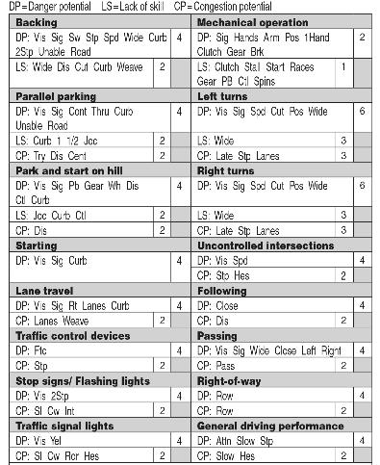
The DT Score Sheet (cont.)
The score sheet is divided into maneuvers with specific points for evaluation. Each mistake or omission is scored by a point deduction
If the performance on a single maneuver is unsatisfactory, a number of points are deducted
Each driving error or omission is scored by circling a point deduction
The designated points should be circled clearly
NOTE: Examiners should NOT circle any point deductions until the Skills Test is over. This helps remove bias from the exam & allows the Examiner to be focused solely on the customer and their surroundings.
NOTE: Scoring only begins once you have left the parking lot, entering the roadway, except for dangerous actions, collisions, and running stop signs.
Notes:
NOTE: Examiners should NOT circle any point deductions until the Skills Test is over. This helps remove bias from the exam & allows the Examiner to be focused solely on the customer and their surroundings.
NOTE: Scoring only begins once you have left the parking lot, entering the roadway, except for dangerous actions, collisions, and running stop signs.

Slide 41
Scoring System
The scoring system is designed so that the applicant’s actions errors, or omissions will be considered and scored as:
Danger Potential (DP): An action that would be potentially dangerous if other traffic, pedestrians, etc. had been present
Lack of Skill (LS): An action that, while not particularly dangerous, clearly indicates a lack of skill
Congestion Potential (CP): An action that is not necessarily dangerous, nor clearly indicates a lack of skill, but would potentially congest or inhibit the normal flow of traffic

Slide 42
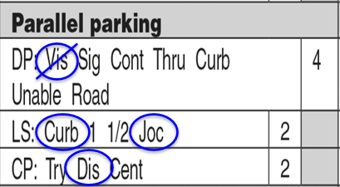
Recording Errors
Circle the abbreviation for the skill on which the error was made
Don’t score the same individual error in more than one location on the score sheet
If an error is duplicated, put a slash thru the previously circled error for each time the error is made
Circle every error you see during the exam
Errors must meet the given definition to be scored

Slide 43
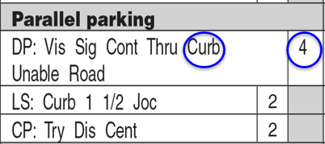
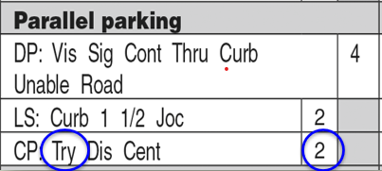
Recording the Score
Circle the corresponding point deduction for the error made
In cases of an error for Lack of Skill or Congestion Potential, the examiner would score only the points for that particular section (i.e. 2 or 3 points).

Slide 44
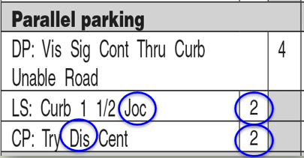
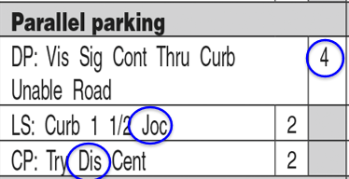
Recording the Score (cont.)
The maximum point deduction that can be deducted in each section of the score sheet is circled. The point deduction for a Danger Potential error is always the maximum allowable points that can be deducted for that category
When errors are circled for both Lack of Skill and Congestion Potential, score the maximum allowable point deduction (i.e. circle the DP point value instead of both LS and CP points).

Slide 45
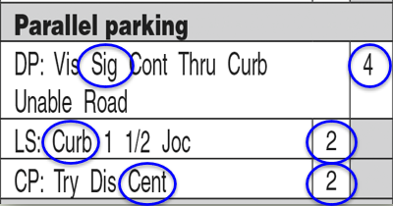
Example
The point deductions will not be made more than once for each type of error.

Slide 46
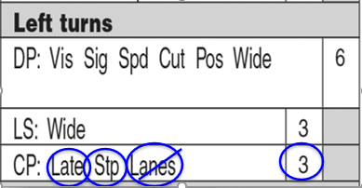
The DT Score Sheet (cont.)
Do NOT multiply deduction scores by the number of errors that were made.
In this example, a single maneuver, Congestion Potential may have a value of three points. The score sheet has been circled and hash marked for four Congestion Potential errors on the maneuver. The deduction is for three points, not twelve.

Slide 47
Reminder
Examiners should score (or circle) every error made during an exam.
Examiners should not wait until the end of the exam to circle errors. They should be circled as they happen or shortly thereafter
However, if you are not sure of the deduction, wait until the end of the test and look up the correct score in the examiner manual. Examiners are to wait until the end of the test before circling the points deducted in each category. This helps prevent the applicant or Examiner from anticipating the result. The circles should be large enough to be clearly readable when adding the deductions at the end of the exam
For each error made there should only be one corresponding error circled (or hash mark)
Examiners should NOT be inserting their own scoring or interpretations into the skills exam. Follow the scoring definitions as written.
Do not circle errors or add points if a DA, FTP, VIO, or ACC occurs as the test has ended and a percentage score is not possible.

Slide 48
READ THE IEGR and DO THE MATH

Slide 49
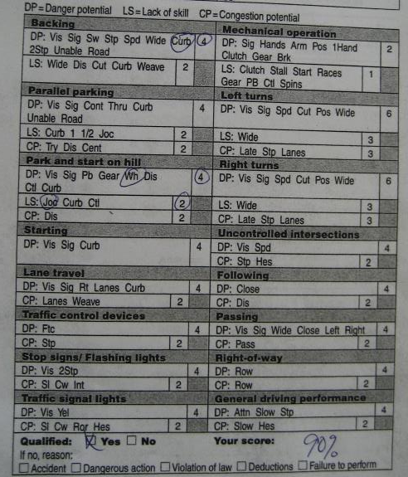
What’s wrong?

Slide 50
INCORRECT SCORING
4 and 2 point deductions were both circled for Park & Start on Hill
No more than the maximum point deduction can be scored for each maneuver
SO……..
Only 4 points should’ve been scored here
Total score should be 92, not 90

Slide 51
What’s going on here?

Slide 52
MORE INCORRECT SCORING
DP:VIS is circled, but the CP score was deducted
2 pts were incorrectly deducted, rather than 4 pts
Total score should be 90 rather than 92
ALSO – Qualified box was not checked

Slide 53
How about this one?

Slide 54
Basic Math
Error
100 pts – 14 pts = 86
Not 84

Slide 55
What’s wrong with this score sheet?

Slide 56
No deductions shown
&
given a score
of 81

Slide 57
FORBIDDEN
Mental scores
will result in a
Re-exam at an LSO
&
could possibly bring action against your school.

Slide 58
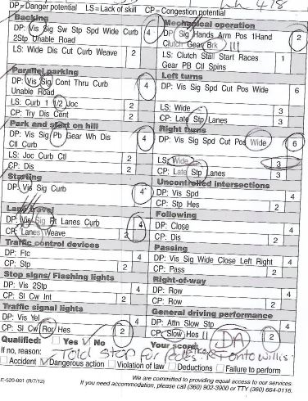
Same customer’s re-exam at an LSO…
Slightly different outcome

Slide 59
On the re-exam, the customer failed with a DA early on. However, despite the disqualification by DA, the LSR continued administering a full Skills Test to accurately depict the customer’s inability to drive and/or follow the rules of the road.
If a DA had not been scored, the customer would’ve received a total score of
65 (w/ 22 deductions)

Slide 60
Did this examiner make any mistakes?

Slide 61
Scored Right Turns – LS – Wide – 3 pts
Did not score Left Turns – CP - Stp
This is important because in some cases it can result in an incorrect final score

Slide 62
Causes for Disqualification
If any of the following occur, the applicant is disqualified and the drive test is ended:
Accident (ACC)
Dangerous Action (DA)
Violation of a Traffic Law (VIO)
Failure to Perform (FTP)
Scoring will stop once any of the above disqualifications occurs
If an ACC, VIO, DA, or FTP occurs, note the dangerous action, the action taken to prevent the collision, and the location, and immediately end the skills exam. The examiner will direct the applicant back to the office by the most direct route and discontinue further scoring. Do not tell the applicant that the exam has ended before returning to the office.
Accumulation of Errors
Did not stop at the stop sign at the corner of Jones St and Smith Ave
76%

Slide 63
Accident
The following are considered accidents:
Contact with a pedestrian
Contact with another vehicle. Any damage including scratches, dents, indentations, scuff marks, or the car alarm goes off caused by contact is considered an accident. However, a slight bumper contact while parking that leaves no mark is not considered an accident. Also, hitting the parallel park stanchions are not considered an accident
Driving onto lawns or shrubbery causing an indentation, deformation, or damage is considered an accident
Contact with a fixed object (e.g. mailbox) is an accident
Remember scoring will stop once a ACC occurs.

Slide 64
Dangerous Action
These are dangerous driving situations by the applicant that are not specific violations of the law:
An accident that was prevented by the expert driving on the part of another (e.g. swerved to avoid a collision or required hard braking)
Dodging out of the way by a pedestrian
The examiner had to assume physical or verbal control of the vehicle (i.e. preventing a collision)
NOTE: Examples of verbal control include an applicant who backs out of a parking stall with fogged windows that have obscured vision enough to become dangerous and therefore you need to tell them to stop or while you are driving you need to instruct an applicant to turn on their windshield wipers when it’s raining or snowing.
Specifically listed driver errors requiring this score (i.e. two wheels on the curb)
NOTE: In situations involving other traffic, there should be a real and immediate threat of collision that can be articulated and listed on the score sheet.
NOTE: Once a dangerous action or verbal control has taken place, which must be described to the applicant, and driving back would be unsafe, you may then ask to drive back or say, “I’ll drive back from here.”
Remember scoring will stop once a DA occurs.
Notes:
NOTE: Examples of verbal control include an applicant who backs out of a parking stall with fogged windows that have obscured vision enough to become dangerous and therefore you need to tell them to stop or while you are driving you need to instruct an applicant to turn on their windshield wipers when it’s raining or snowing.
NOTE: In situations involving other traffic, there should be a real and immediate threat of collision that can be articulated and listed on the score sheet.
NOTE: Once a dangerous action or verbal control has taken place, which must be described to the applicant, and driving back would be unsafe, you may then ask to drive back or say, “I’ll drive back from here.”

Slide 65
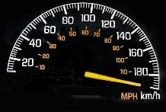
Violation
Violations are limited to the following situations only. If a violation occurs, calmly bring to the applicant’s attention what event just happened (i.e. “There was a stop sign at that last turn”), but wait until returning to the start point before informing them that they have disqualified.
Speeding is scored only when the applicant exceeds the speed limit by more than five mph (i.e. six or more miles an hour). Bring their speed to the attention of the applicant, (i.e. “You are driving ___ miles an hour.” After the violation has occurred you may limit their speed for safety reasons
Failure to stop for a stop sign or traffic light
Do NOT score VIO for failing to settle the vehicle at a stop. If the passing scenery stopped, even for a brief moment, do not score VIO
Driving on the wrong side of the road (e.g. being more than a tire width over a marked lane separating opposing traffic or having more than 50% of the car over the opposing traffic side of an unmarked road with two directions of travel
Driving straight in a turning-lane
Turning from a straight-ahead lane
Driving the wrong way on a one-way street
Any time an applicant is stopped by law enforcement and receives a warning or a citation
NOTE: Do not score a VIO or DA for not using their seat belt
Remember scoring will stop once a VIO occurs.
Notes:
NOTE: Do not score a VIO or DA for not using their seat belt

Slide 66
Failure to Perform
If an applicant is unable or unwilling to comply after they are told an action is required (e.g. applicant refused to try a maneuver and you were not able to assess anything or they state that they cannot perform the required action), The examiner must advise them this would be a cause for disqualification. If the applicant still refuses to try the maneuver the exam is ended.
The examiner will indicate the reason and number of times the applicant was warned at the bottom of the score sheet marked “if no, reason.” Discontinue the exam and direct the applicant back to the school. Do not advise the applicant of their disqualification until you have arrived at the school.
During the examination, if the applicant repeatedly fails to follow instructions or directions on the skills exam such they cannot complete the directions in a reasonable period of time, preventing completion of the exam.
Missing one turn is not a failure to perform. In this case, directly return to the course and continue the test. On the other hand, repeated deviation from the course is a failure to perform. With that in mind, it is the Examiners responsibility to say the directions early enough, clarify if it appears the applicant did not understand, and assist in needed clarifications in a timely manner if the applicant appears to be turning off the route.
The skills test is not to be a test of language understanding. Examiners should use other means of communication whenever it appears that there may be a language barrier or a complete failure to understand instructions including paraphrasing instructions, using gestures, or drawing pictures to clarify instructions on a separate piece of paper.
Failure to perform cannot be scored until the applicant has begun the test.
NOTE: Scoring FTP for leaving the route should be very rare.
Remember scoring will stop once a FTP occurs.
Notes:
NOTE: Scoring FTP for leaving the route should be very rare.

Slide 67
Accumulation of Errors
Accumulation of more than 20 points will disqualify an applicant. However, accumulation of errors (even if a failing score) does not immediately end the test. Without another type of disqualification occurring, continue the test and test scoring until completion. At the conclusion of the examination:
Circle the point deductions
Add the point deduction for each section of the exam
Subtract the total from 100 to obtain the applicant's score
A score of 80 or better is passing
Double check your math

Slide 68
Module 4 Scoring the Drive Test
Certified Examiner Training

Slide 69
Scoring the Skills Test
GOLDEN RULE:
If it is not on the score sheet
OR in the Examiner’s manual
it should not be scored

Slide 70
Scoring for Vision (VIS)
VISION (VIS) is scored when the customer doesn’t use best possible vision when entering or leaving traffic, making lane changes, backing, entering intersections, etc. Best possible vision for each maneuver is identified in each scoring section.
Best possible vision depends on the vehicle
You are expected to use good judgment & be practical when scoring vision
Vehicles equipped with monitors, that allow a view of what is to the rear of the vehicle, can not be utilized during the Skills Test
Do not block the monitor with your clipboard
Do not score an applicant who occasionally views the camera image but do score an applicant who fails to use their best possible vision most of the time (i.e. more than 50% of the time)
Vision may be scored for not checking for traffic at all or was improperly done (e.g. checking vision late or too early to be timely)
Do give credit if an applicant appeared to use their peripheral vision
Notes:
Best possible vision depends on the vehicle
NOTES: When an applicant is driving a vehicle with obscured vision or no side windows, best possible vision may be using mirrors rather than looking over their shoulder into the blind spot area of the vehicle
Vehicles equipped with monitors, that allow a view of what is to the rear of the vehicle, can not be utilized during the Skills Test
NOTES: An applicant is still expected to turn and look behind and to the sides of the vehicle when backing. Advise the applicant who has a back-up camera that this will not be considered a substitute for best vision during the test.

Slide 71
Scoring for Signal (SIG)
Signal (SIG) is scored when a signal is required under the scoring rules, and it is not used at all, is late, or was done in the wrong direction.
If signal is not disengaged or put on unnecessarily (this is scored under mechanical operation)
NOTE: Examiners are expected to use good judgment if the car disengages the signal, and the applicant correctly puts it back on.
Notes:
NOTE: Examiners are expected to use good judgment if the car disengages the signal and the applicant correctly puts it back on.

Slide 72
Backing
Examples when to disqualify an applicant:
Applicant backs wide, going over the center of the road and does not return to their lane of travel stop the exam and score as Dangerous Action
Applicant backs over (on top of) the curb with more than one wheel (or two axles for if a dually truck), either with one wheel then another on the same attempt or both are on the curb at the same time, score as a Dangerous Action
Applicant causes damage to lawn, shrubs, etc., score as an Accident
Applicant fails to stop for an approaching car from the rear that is so near as to represent a risk of collision, score as Dangerous Action (do not score if applicant stopped and the other car went around)

Slide 73
Backing (cont.)
Danger Potential (DP):
Fails to utilize best possible vision to check traffic in all vulnerable areas. For best possible vision while backing, the applicant should turn and be looking primarily out the rear window unless use of mirrors is best possible vision, i.e., enclosed camper or van. Prior to the turn, applicants should check in all vulnerable areas for potential cross traffic and pedestrians. Before re-entering traffic, checking of the “blind spot” on the left side is required if movement of a car width or more to the left is made (VIS)
NOTE: The customer must look to the rear of the vehicle 50% of the time while the vehicle is moving backwards, including during re-positioning to re-enter traffic. If not, VIS is scored.
Notes:
NOTE: The customer must look to the rear of the vehicle 50% of the time while the vehicle is moving backwards, including during re-positioning to re-enter traffic. If not, VIS is scored.
Reminder: Driving to the side of the road to begin backing is scored under lane travel (VIS)

Slide 74
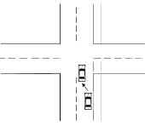
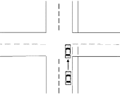
Backing (cont.)
Danger Potential (DP):
After stopping, the customer fails to use the required signal when re-entering traffic. One car-width movement to the left is required to be scorable (SIG)
NOTE: Continuing straight (next to the edge of the street) is not scored; unless a lane change or passing maneuver is made (at some point) to re-enter traffic. If significant distance has been driven since completion of the maneuver, score appropriate VIS or SIG deductions under Lane Travel or Passing sections.
Notes:
NOTE: continuing straight (next to the edge of the street) is not scored; unless a lane change or passing maneuver is made (at some point) to re-enter traffic. If significant distance has been driven since completion of the maneuver, score appropriate VIS or SIG deductions under Lane Travel or Passing sections.
Reminder: Driving to the side of the road to begin backing is scored under lane travel (SIG)
Reminder: Signal is not required while backing around the corner.

Slide 75
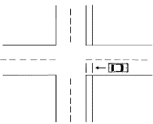
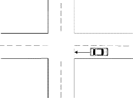
Backing (cont.)
Danger Potential (DP):
Fails to stop at sidewalk area, if present (with or without street markings) SW)
Fails to stop before entering travel portion of road, when no sidewalk is present (STP)
NOTE: Do not score SW and STP in the same maneuver.
NOTE: Driving to the side of the road to begin backing is scored under lane travel.
Notes:
Reminder: (STP) is not a violation, only a deduction.
NOTE: Do not score SW and STP in the same maneuver.
NOTE: Driving to the side of the road to begin backing is scored under lane travel.

Slide 76
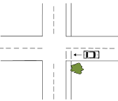
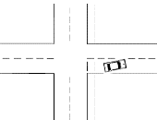
Backing (cont.)
Danger Potential (DP):
Fails to make a second stop (if needed) to look for traffic at an obscured corner, alley or driveway. Do not score if the customer safely edges out and looks for traffic (2STP)
Prior to the turn, unable to back the car around the corner, striking the curb three times. Stop the maneuver, score everything you see and continue the rest of the test (UNABLE)
NOTE: If the applicant backs wide, going over the center of the road and does not return to their lane of travel, stop the test and score as Dangerous Action (DA).
Notes:
NOTE: Do not score UNABLE after the turn has been made
NOTE: If the applicant backs wide, going over the center of the road and does not return to their lane of travel, stop the test and score as Dangerous Action (DA).

Slide 77
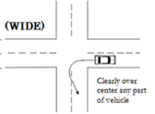
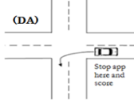
Backing (cont.)
Danger Potential (DP):
Backs too fast and is out of control. Use good judgment. Some customers have better backing skills than others (SPD)
Backs wide, going over center of the road (WIDE)
NOTE: If the applicant backs wide, going over the center of the road and does not return to their lane of travel, stop the test and score as Dangerous Action (DA).
Notes:
NOTE: If the applicant backs wide, going over the center of the road and does not return to their lane of travel, stop the test and score as Dangerous Action (DA).

Slide 78
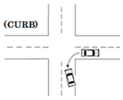
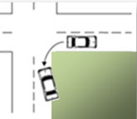
Backing (cont.)
Danger Potential (DP):
After the turn, backs up on the curb with one wheel or strikes the curb and is unable to continue backing as a result (CURB)
With no curb present, backs off the road with one or more wheels and no damage to property (ROAD)
NOTE: If the customer backs over the curb with more than one wheel, score as (DA). If it causes damage to lawn, shrubs, mailbox, etc., score as (ACC).
Notes:
NOTE: If the customer backs over the curb with more than one wheel, score as (DA). If it causes damage to lawn, shrubs, mailbox, etc., score as (ACC).
NOTE: (ROAD) This includes driving off the road onto a graveled area.

Slide 79
Backing (cont.)
Lack of Skill (LS):
Backs wide (not over center of the road) during turn and right rear wheel is in excess of 18” from the curb or edge of the road (visual approximation) (WIDE)
On the straight line backing portion, does not keep vehicle within 18” of road’s edge (visual approximation) (DIS)
Notes:
NOTE: On the backing maneuver, there should be a straight line backing of two and a half car lengths (approximately 50 feet)
NOTE: (DIS) Score after going around the corner, not before.

Slide 80
Backing (cont.)
Lack of Skill (LS):
Cuts across corner where no curb exists (applies to either backing around the corner or dropping off the curb from a driveway/alleyway) (CUT)
While backing, strikes curb (does not stop movement) (CURB)

Slide 81
Backing (cont.)
Lack of Skill (LS):
Once around the corner, does not keep vehicle in a straight line on the straight portion of test (WEAVE)

Slide 82
Parallel Parking
Examples when to disqualify an applicant:
When there is damage to property, it is scored as an Accident
When there is more than one wheel over the curb, score as Dangerous Action
Examiner intervenes physically or verbally to stop applicant from hitting either a parked car or approaching car, score as a Dangerous Action
When passing car is forced to swerve into another lane or brake hard to stop score as a Dangerous Action.
Vehicle alarm goes off as a direct result of making physical contact score as an Accident

Slide 83
Parallel Parking (cont.)
Applicants with vehicles that have an automatic feature to assist parallel parking will be advised they cannot use the automatic feature and must manually parallel park the vehicle.
Danger Potential (DP):
Fails to utilize best possible vision when entering, leaving or within parking space. For best possible vision while backing the customer should turn and be primarily looking out the rear window, unless use of mirrors is best possible vision (i.e. enclosed camper or van). Before re-entering traffic, a check of the blind spot on the left side is required, including (VIS)
Before re-entering traffic for a second attempt, a check of the “blind spot” on the left side is required. An additional attempt occurs when 50% or more of the vehicle leaves the space (i.e. when (TRY) is scored) (VIS)

Slide 84
Parallel Parking (cont.)
Danger Potential (DP):
Fails to signal properly when leaving parked position. Signal is scored leaving the parking area when no signal or improper signal is given and hand signal is not given when turn indicator cannot be readily observed by street traffic (SIG)
Bumper contact with another vehicle (no damage) or strikes poles. (Damage to poles is not scored as an accident) (CONT)
NOTE: When parking between two cars, if the vehicle size or position is such that it cannot be seen by oncoming cars from the rear when re-entering traffic, a left arm signal may be required.
Notes:
NOTE: When parking between two cars, if the vehicle size or position is such that it cannot be seen by oncoming cars from the rear when re-entering traffic, a left arm signal may be required.
NOTE: (CONT) regardless if damage occurs to the stanchions

Slide 85
Parallel Parking (cont.)
Danger Potential (DP):
Drives forward or backs through poles (THRU)
Backs over curb with one wheel (CURB)
NOTE: If there is damage to property, it is scored as an accident (ACC). If there is more than one wheel over the curb, stop the customer. More than one wheel over the curb with no damage to property is scored as a Dangerous Action (DA).
Notes:
Reminder: (THRU) Turn as necessary to observe where the applicant is looking and where the car is going
NOTE: If there is damage to property, it is scored as an accident (ACC). If there is more than one wheel over the curb, stop the customer. More than one wheel over the curb with no damage to property is scored as a Dangerous Action (DA).

Slide 86
Parallel Parking (cont.)
Danger Potential (DP):
Score the applicant after they have made two attempts to park and still not properly parked. If the customer does not back in, the instructions were not understood. Give additional instructions and allow a second attempt (UNABLE)
NOTE: Score all errors made up until that point.
Positions vehicle so that the passenger side wheels are past the poles, as if on curb, but no curb is present (ROAD)
NOTE: When parking between poles or stanchions, no left arm signal is required when re-entering traffic.
Notes:
NOTE: (UNABLE) Score all errors made up until that point. (e.g. Lack of Skill Jockeying or Congestion Potential TRY).
NOTE: When parking between poles or stanchions, no left arm signal is required when re-entering traffic.

Slide 87
Parallel Parking (cont.)
Lack of Skill (LS):
Strikes curb while attempting to park, stopping vehicle movement. Wheel does not go over curb (CURB)
NOTE: If you could barely feel contact be aware that perhaps the vehicle is only touching it rather than having been stopped by the curb. If you are not sure, do not score it. Also, if a gentle scrape occurs that did not stop the vehicle, then do not score it.
Fails to park within designated 1 ½ car lengths (Visual approximation 30 feet). The 1 ½ deduction should be scored when parking and/or when the customer is positioning to leave the parking space (1 ½)
Notes:
NOTE: (CURB) If you could barely feel contact be aware that perhaps the vehicle is only touching it rather than having been stopped by the curb. If you are not sure, do not score it. Also, if a gentle scrape occurs that did not stop the vehicle, then do not score it.

Slide 88
Parallel Parking (cont.)
Lack of Skill (LS):
Excessive jockeying by the customer moving back and forth within parking space. Score if more than three moves are made entering and/or leaving (JOC)
NOTE: Parallel parking should require no more than three moves (to enter or leave). Do not combine moves made to back into the space with those made to leave the space, or with additional attempts to park.
HINT: When counting moves, use gear changes and/or change of direction as an indicator of each move (puts vehicle from Drive into Reverse or likewise).
NOTE: If while parking, the customer moves the vehicle six times in the space, stop the maneuver, score everything you see and instruct the customer to re-enter traffic to continue the test.
Notes:
NOTE: Do not combine moves made to back into the space with those made to leave the space, or with additional attempts to park.
HINT: When counting moves, use gear changes and/or change of direction as an indicator of each move (puts vehicle from Drive into Reverse or likewise). Each vehicle movement is counted as one, even if it was not a straight line or there were pauses in vehicle movement. After backing into the space (first move), and after a subsequent forward movement (second move), if the applicant then backs again to center the vehicle, this becomes the third movement.
NOTE: After the applicant moves the vehicle six times in the space without exiting, stop the maneuver, score everything you see (i.e. DIS) and advise the applicant to re-enter traffic (do not score UNABLE) score as JOC

Slide 89
Parallel Parking (cont.)
Congestion Potential (CP):
Makes more than one attempt to back from the travel portion of the road (must have backed at least ½ the car into the parking space to be considered an attempt) (TRY)
NOTE: If a second attempt is made, all deductions made on either attempt is scored.
NOTE: Examiners may allow customers a second try at parallel parking if the customer asks. However, Examiners should not be prompting customers to try again.
NOTE: A second attempt is for that maneuver location, and attempting a second parallel park at another location is not permitted.
NOTE: If the applicant does not back in (i.e. drives through the cones without parallel parking) the instructions were not understood, that scoring is not counted, and a second attempt is allowed at another location.
Notes:
NOTE: If a second attempt is made, all deductions made on either attempt is scored.
NOTE: Examiners may allow customers a second try at parallel parking if the customer asks. However, Examiners should not be prompting customers to try again.
NOTE: A second attempt is for that maneuver location, and attempting a second parallel park at another location is not permitted.
NOTE: If the applicant does not back in (i.e. drives through the cones without parallel parking) the instructions were not understood, that scoring is not counted, and a second attempt is allowed at another location.

Slide 90
Parallel Parking (cont.)
Does not park within 12” from the curb, the passenger side poles or the edge of road when no curb (visual approximation). Small cars inside the space, but more than 12” from the curb, poles or edge of road will be scored even though they may not be out in the lane of traffic (DIS)
Fails to center the vehicle properly and is too far forward or back (use approximation ) (CENT)
Notes:
(CENT) Fails to center vehicle properly between vehicles, delineators (traffic stanchions) or within a designated area, being either too far forward or back (use approximation)

Slide 91
Park and Start on a Hill
Examples when to disqualify an applicant:
When there is damage to property, it is scored as an Accident
When there is more than one wheel over the curb, score as Dangerous Action
Examiner intervenes physically or verbally to stop applicant from hitting either a parked car, approaching car, or an object, score as a Dangerous Action
Surrounding traffic takes evasive action to avoid a collision (i.e. swerves into another lane or brakes hard), score as a Dangerous Action

Slide 92
Park and Start on Hill (cont.)
Danger Potential (DP):
Fails to use best possible vision when re-entering traffic moving to the left, “checking blind-spot,” or fails to use best vision while moving within the parking space (VIS)
Fails to give proper signal when entering traffic (SIG)
NOTE: If movement to the left is made, the customer must signal and check “blind spot” prior to re-entering traffic
REMINDER: Reminder that blind spot does not mean touching the chin to the shoulder
Notes:
NOTE: If movement to the left is made, the customer must signal and check “blind spot” prior to re-entering traffic
Reminder: Moving into the space is scored under lane trave
REMINDER: Reminder that blind spot does not mean touching the chin to the shoulder

Slide 93
Park and Start on Hill (cont.)
Danger Potential (DP):
Fails to secure the parking brake (PB)
NOTE: If parking brake is not released when attempting to leave, advise the applicant so they do not damage their vehicle and score under mechanical operation (PB). If vehicle automatically engages the parking brake and is unable to be turned off or be manually engaged, do not score.
Fails to put manual transmission in gear or an automatic transmission in park (GEAR)
Notes:
NOTE: If parking brake is not released when attempting to leave, advise the applicant so they do not damage their vehicle and score under mechanical operation (PB). If vehicle automatically engages the parking brake and is unable to be turned off or be manually engaged, do not score.

Slide 94
Park and Start on Hill (cont.)
Danger Potential (DP):
Fails to turn front wheels in proper direction (WH)
Fails to position front tire, or entire car within approximately 12” of the curb or edge of the road (DIS)
Notes:
NOTE: (WH) If the applicant attempts to turn the wheel correctly, either partially or when the curb hinders movement, do not score as an error
NOTE: Two wheels over the curb is scored as a Dangerous Action (DA)

Slide 95
Park and Start on Hill (cont.)
Danger Potential (DP):
Does not maintain complete control of vehicle or allows vehicle to roll forward or backward significantly while parking (CTL)
One wheel over the curb when leaving (CURB)
NOTE: Two wheels over the curb is scored as a Dangerous Action (DA)
Notes:
NOTE: Two wheels over the curb is scored as a Dangerous Action (DA)

Slide 96
Park and Start on Hill (cont.)
Lack of Skill (LS):
Make more than two moves when positioning vehicle after driving to the side of the road (jockeying back and forth) (JOC)
Strikes curb when leaving parked position (if only slight scrape do not score) (CURB)

Slide 97
Park and Start on Hill (cont.)
Lack of Skill (LS):
Releases parking brake before vehicle is controlled by engine or foot brake (CTL)
Congestion Potential (CP):
Rear tire over 12” from curb or edge of road (DIS)

Slide 98
Starting
Examples when to disqualify an applicant:
When there is damage to property, it is scored as an Accident
When two wheels are over the curb, score as Dangerous Action
Examiner intervenes physically or verbally to stop applicant from hitting either a parked car, approaching car, or object, score as a Dangerous Action
Surrounding traffic takes evasive action to avoid a collision (i.e. swerves into another lane or brakes hard), score as a Dangerous Action

Slide 99
Starting (cont.)
Danger Potential (DP):
Fails to use best possible vision when re-entering traffic (VIS)
Fails to signal properly when re-entering traffic (SIG)
Notes:
Reminder: Driving to the side of the road is scored under lane travel

Slide 100
Starting (cont.)
Danger Potential (DP):
Goes over curb or off shoulder of road with one wheel when leaving parked position (CURB)
NOTE: Two wheels over curb or off shoulder of road is a dangerous action (DA)
Notes:
NOTE: Two wheels over curb or off shoulder of road is a dangerous action (DA)

Slide 101
Traffic Control Devices
Examples when to disqualify an applicant:
When the applicant drives the wrong direction (i.e. cuts in front) of a neighborhood traffic circle or roundabout regardless of size, score as a Violation
When there is damage to property, it is scored as an Accident
When there is more than one wheel over the curb, score as Dangerous Action
Examiner intervenes physically or verbally to avoid an imminent collision, score as a Dangerous Action

Slide 102
Traffic Control Devices (cont.)
Danger Potential (DP):
Fails to comply with or take necessary precaution when indicated by a traffic control device (i.e. yield signs, traffic cones, railroad signs, traffic dividers, flashing yellow lights, bicycle lanes, white fog lines, round-a-bouts, traffic circles, construction or law-enforcement barriers etc). This includes striking or putting one wheel over the curb in a roundabout or traffic circle (FTC)
NOTE: Do not score FTC for bike lane or parking lane when part of making a turn. Do not score for yellow warning signs or speed bumps.
Congestion Potential (CP):
Makes unnecessary stop at traffic control device (yield sign, railroad crossing, school zone sign, etc) (STP)
Notes:
NOTE: Do not score (FTC) for bike lane or parking lane when part of making a turn. Do not score for yellow warning signs or speed bumps.

Slide 103
Lane Travel
Examples when to disqualify an applicant:
If applicant drives over the marked centerline of a two-way street by more than one tire width, score as a violation for driving on the wrong side of the road
If the applicant drives more than 50% of their vehicle over the center of an unmarked two-way street, score as a violation. Do not score if it was appropriate for the applicant to do so based on directions provided to them or when necessary to legally drive around an obstacle
Examiner intervenes physically or verbally to avoid an imminent collision
Another driver has to brake hard or swerve to avoid a collision (being caused by the applicant)
An automatic lane departure system controls the car preventing a near collision

Slide 104
Lane Travel (cont.)
Lane changes made while in traveling in traffic or while driving to the side of the road for Backing Around the Corner, Park & Start on Hill and Starting maneuvers will be scored in this area. Movement of one car width to the left or right is necessary before scoring in Lane Travel.
Danger Potential (DP):
Fails to use best possible vision (usually a blind spot check) to determine if a lane change can be made safely (VIS)
Fails to signal before changing lanes or Fails to signal (100 feet) before changing lanes (SIG)
Note: Movement into another lane or movement of one car width to the left or right is necessary before scoring VIS or SIG under Lane Travel. However, do not score if the lane was protected by a physical barrier (i.e. dividing wall).
Notes:
Note: Movement into another lane or movement of one car width to the left or right is necessary before scoring VIS or SIG under Lane Travel. However, do not score if the lane was protected by a physical barrier (i.e. dividing wall).

Slide 105
Lane Travel (cont.)
Danger Potential (DP):
Does not keep to the right where no clear center line or center markers are visible on a two-way street (RT)
Does not keep vehicle in a single lane or overlaps lanes where two or more lanes in the same direction are clearly marked. Crosses marked center line on a two-way street (LANES)
NOTE: If more than one tire width is over a marked center line on a two-way street, score as a violation (VIO).
Notes:
NOTE: If more than one tire width is over a marked center line on a two-way street, score as a violation (VIO).

Slide 106
Lane Travel (cont.)
Danger Potential (DP):
Strikes curb or puts one wheel over the curb when driving to the side of the road (CURB)
Congestion Potential (CP):
Occupies both lanes where there are two or more lanes in one direction and the lanes are not marked or defined, creating confusion of intentions (LANES)

Slide 107
Lane Travel (cont.)
Congestion Potential (CP):
Changes lanes unnecessarily back and forth from one lane to another (i.e. around parked vehicles) (WEAVE)

Slide 108
Stop Sign/Flashing Red Traffic Light
Examples when to disqualify an applicant:
Applicant fails to stop, score as a Violation
Examiner intervenes physically or verbally to avoid an imminent collision

Slide 109
Stop Sign/Flashing Red Traffic Light
Danger Potential (DP):
Fails to look both directions before starting (VIS)
Fails to make a second stop (or fails to edge out slowly) when needed (2STP)
When a vehicle ahead has stopped, causing applicant to stop one car length or more before stop line, intersection, or crosswalk (2STP)
NOTE: If they stopped within the area of the intersection already, do not score VIO.
NOTE: Do not score if the customer safely edges out and looks for traffic, but doesn’t need to stop a second time
EXAMPLES: When the view is obstructed and an additional stop is needed to observe for cross traffic or to yield right-of-way; or when stop line is excessively far back from edge of the intersection and an additional stop is needed to safely proceed.
Notes:
NOTE: (2STP) If they stopped within the area of the intersection already, do not score VIO.
NOTE: Do not score if the customer safely edges out and looks for traffic, but doesn’t need to stop a second time

Slide 110
Stop Sign/Flashing Red Traffic Light (cont.)
Congestion Potential (CP):
Fails to stop before crossing the designated stop line (SL)
Fails to stop before entering a marked crosswalk (CW)
NOTE: Only score when the wheel well of the vehicle has reached the scored location (i.e. do not score if only the bumper is past the marked stop line). If the stop line is so faded as to be too difficult to see do not score.
Notes:
NOTE: Only score when the wheel well of the vehicle has reached the scored location (i.e. do not score if only the bumper is past the marked stop line). If the stop line is so faded as to be too difficult to see do not score. An applicant is not required to stop prior to an unmarked sidewalk

Slide 111
Stop Sign/Flashing Red Traffic Light (cont.)
Congestion Potential (CP):
Fails to stop before the edge of the road or intersection when there is no marked crosswalk or designated stop line (INT)
NOTE: If there is a stop line and crosswalk at the same stop sign, score only the last applicable error. In cases where both SL and CW road markings are present and could be scored, score only crosswalk (CW), however, if the applicant also goes into the intersection, score only INT.
Notes:
NOTE: If there is a stop line and crosswalk at the same stop sign, score only the last applicable error. In cases where both SL and CW road markings are present and could be scored, score only crosswalk (CW), however, if the applicant also goes into the intersection, score only INT.

Slide 112
Traffic Signal Light
Examples when to disqualify an applicant:
Applicant fails to stop, score as a Violation
Examiner intervenes physically or verbally to avoid an imminent collision

Slide 113
Traffic Signal Light (cont.)
Danger Potential (DP):
Fails to look both directions before starting, when driving straight through the intersection, if the customer’s vehicle is the first in the lane (VIS)
Fails to anticipate a change of signal on approach, entering on yellow when stop could have been made safely (YEL)
NOTE: If turning at a traffic light, score VIS under the Left/Right Turn sections.
Do not score the applicant VIO if they enter on a green or yellow light and they do not clear the intersection before the light turns red. If the light is red prior to entering the intersection then score VIO. Score YEL if they entered on a yellow light and could have stopped but did not. A score of ATTN is possible depending on what occurred such as an obvious failure to react safely to pedestrians, road conditions, and other cars.
Notes:
NOTE: If turning at a traffic light, score VIS under the Left/Right Turn sections.
Do not score the applicant VIO if they enter on a green or yellow light and they do not clear the intersection before the light turns red. If the light is red prior to entering the intersection then score VIO. Score YEL if they entered on a yellow light and could have stopped but did not. A score of ATTN is possible depending on what occurred such as an obvious failure to react safely to pedestrians, road conditions, and other cars.

Slide 114
Traffic Signal Light (cont.)
Congestion Potential (CP):
Fails to stop before crossing a designated stop line (SL)
Fails to stop before entering a marked crosswalk (CW)
NOTE: If there is a stop line and crosswalk at the same traffic signal light, score the last applicable error. In cases where both SL and CW road markings are present and could be scored, score only crosswalk (CW).
Notes:
NOTE: If there is a stop line and crosswalk at the same traffic signal light, score the last applicable error. In cases where both SL and CW road markings are present and could be scored, score only crosswalk (CW).

Slide 115
Traffic Signal Light (cont.)
Congestion Potential (CP):
Fails to turn right on red after stopping when no prohibiting sign is posted (ROR)
NOTE: Do not score if vision is obscured or if the ability to make turn safely is in question
Stops unnecessarily or fails to proceed when traffic light is green (HES)
Notes:
NOTE: (ROR) Do not score if vision is obscured or if the ability to make turn safely is in question

Slide 116
Mechanical Operation
Danger Potential (DP):
Fails to manually cancel turn signal if it does not shut off automatically; or if the customer signals when no turn or lane change is being made (SIG)
Drives unnecessarily with less than 1/3 of steering wheel between hands; or if the hands are positioned anywhere other than on the outside of the rim. Only score when the car is in motion. (HANDS)
Drives with hands positioned anywhere other than the outside of rim. Drives only using their fingers to hold the steering wheel (HANDS)
NOTE: Do not score HANDS if an applicant’s hand position changes or are inside the rim of the steering wheel during turns, as long as they return to proper hand control position after turning is complete. Use visual approximation to evaluate. If you are unsure, do not score.
NOTE: Do not use the ability to touch thumbs together as a measure of the 1/3 rule. This is due to the differences in hand sizes. Only apply rules defined in the manual.
Notes:
NOTE: (HANDS) Only score when the car is in motion. Do not score HANDS if an applicant’s hand position changes or are inside the rim of the steering wheel during turns, as long as they return to proper hand control position after turning is complete. Use visual approximation to evaluate. If you are unsure, do not score.
NOTE: Do not use the ability to touch thumbs together as a measure of the 1/3 rule. This is due to the differences in hand sizes. Only apply rules defined in the manual.

Slide 117
Mechanical Operation (cont.)
Elbow out of window or on sill while driving (ARM)
Seated in a manner impairing vision or vehicle control (POS)

Slide 118
Mechanical Operation (cont.)
Danger Potential (DP):
Unnecessary one hand driving (i.e. shifting or giving hand signals while turning or extended driving while unnecessarily leaving hand on the shifter) (1HAND)
Fails to depress clutch when starting engine; car lurches forward (CLUTCH)

Slide 119
Mechanical Operation (cont.)
Puts selector in improper gear causing the vehicle to go in the wrong direction (GEAR)
Unnecessary hard braking (BRK)

Slide 120
Mechanical Operation (cont.)
Lack of Skill (LS):
Jerky clutch engagement (CLUTCH)
Stalls engine (STALL)

Slide 121
Mechanical Operation (cont.)
Difficulty starting engine (if turned off while on the test). Do not score if vehicle is at fault (START)
NOTE: Do not score if the applicant grinds the ignition.
Excessively races engine (RACES)
Notes:
NOTE: (START) do not score if the applicant grinds the ignition.

Slide 122
Mechanical Operation (cont.)
Improper shifting or clashes gears; fails to shift when necessary or starts in improper gear (GEAR)
Fails to release the parking brake (PB)

Slide 123
Mechanical Operation (cont.)
Lacks knowledge of the vehicle’s controls and/or does not properly use them (i.e. windshield defroster, wipers, lights, etc) (CTL)
Spins wheels excessively on wet or slick road (SPINS)
NOTE: If vision is obstructed due to windows being fogged by rain, ice, snow or other conditions and the customer proceeds without taking action causing driving to become hazardous, score as a Dangerous Action (DA).
Notes:
NOTE: If vision is obstructed due to windows being fogged by rain, ice, snow or other conditions and the customer proceeds without taking action causing driving to become hazardous, score as a Dangerous Action (DA).

Slide 124
Left and Right Turns
Danger Potential (DP):
Fails to use best possible vision prior to and during turns while observing for traffic or pedestrians (VIS)
Fails to give correct signal for at least 100 feet (or five car lengths) before turn, unless at a stop sign or red traffic light (SIG)
NOTE: Do not score if a customer approaches a stop sign or red traffic light, stops and then signals their intent to turn prior to proceeding.
Notes:
NOTE: Do not score if a customer approaches a stop sign or red traffic light, stops and then signals their intent to turn prior to proceeding.

Slide 125
Left and Right Turns (cont.)
Approaches or goes into turn too fast requiring braking in turn (SPD)
Cuts corner. On right turn, hits or goes over curb or off road with one wheel or on left turn goes over marked centerline, or the center of an unmarked road (CUT)
Notes:
NOTE: (SPD) This is a measure of how safe the turn is being made and is scored when excessive braking occurs.

Slide 126
Left and Right Turns (cont.)
Fails to move as far to the right or left as practical before turning (when lanes are not defined or the road is extremely wide). Practical means far enough either way to prevent other vehicles from passing or squeezing thru on the turning side (POS)
NOTE: Do not score when barriers such as parked cars preclude a car from passing. For unmarked roads, use visual approximation of the centerline when making a left turn.
Completes turn into improper (i.e. farthest) lane, or on right turn crosses centerline or center of road so that part of vehicle is partially on the wrong side of the road (temporarily crossing with no more than one tire), or on left turns one wheel is off the road (WIDE)
Notes:
NOTE: (POS) Do not score when barriers such as parked cars preclude a car from passing. For unmarked roads, use visual approximation of the centerline when making a left turn.

Slide 127
Left and Right Turns (cont.)
Lack of Skill (LS):
Turns wide (partially or entirely leaves lane), but completes turn into proper lane (WIDE)
Congestion Potential (CP):
Late getting into turn lane or proper lane prior to turn (LATE)

Slide 128
Left and Right Turns (cont.)
Congestion Potential (CP):
Stops vehicle unnecessarily at intersections (STP)
Turns to center of lane, straddling two marked or unmarked lanes (LANES)
FOR EXAMPLE: This situation is when applicants straddle lanes going in the same direction of travel during a turn. This can occur on any road having more than one lane of travel in the same direction.
Notes:
FOR EXAMPLE: (LANES) This situation is when applicants straddle lanes going in the same direction of travel during a turn. This can occur on any road having more than one lane of travel in the same direction.

Slide 129
Uncontrolled Intersections
Examples when to disqualify an applicant:
If there is an accident
Examiner intervenes physically or verbally to stop applicant from hitting another car
Another car or pedestrian has to take evasive action to avoid a collision.

Slide 130
Uncontrolled Intersections (cont.)
Danger Potential (DP):
Fails to observe all possible areas for approaching traffic prior to entering intersection. If view is clear upon approach to intersection, vision is not scored (VIS)
Fails to decrease speed, as necessary, before entering intersection (SPD)
NOTE: An uncontrolled intersection is a 3 or 4-way intersection without any signs, lights or traffic devices that control traffic flow. Score only when turn is not made.
Notes:
NOTE: An uncontrolled intersection is a 3 or 4-way intersection without any signs, lights or traffic devices that control traffic flow. Score only when turn is not made.

Slide 131
Uncontrolled Intersections (cont.)
Congestion Potential (CP):
Makes unnecessary stop at uncontrolled intersection with an unobstructed view (STP)
Hesitates to almost a stop when approaching an uncontrolled intersection with an unobstructed view (HES)
NOTE: Deductions are only scored under uncontrolled intersections when driving straight thru them. If a turn is made, it is scored under Left/Right Turn sections.
Notes:
NOTE: Deductions are only scored under uncontrolled intersections when driving straight thru them. If a turn is made, it is scored under Left/Right Turn sections.

Slide 132
Following
Danger Potential (DP):
While driving, follows too close for conditions, existing traffic or road/weather conditions (i.e. unable to react safely to traffic conditions) (CLOSE)
Congestion Potential (CP):
Leaves more than one car length of distance (approximately 20’) between their vehicle and the vehicle stopped ahead of them at stop sign or signal (DIS)

Slide 133
Passing
Passing may occur on multilane roads or residential roads, and includes legally having to pass buses, garbage trucks, or parked cars that block the road.
Danger Potential (DP):
Applicant fails to use best possible vision prior to or after passing (VIS)
Fails to signal prior to passing or after completion of pass (SIG)
Note: Do not score for crossing lines if directed by cones, police officer, or as legally necessary and safe to do.
Notes:
Note: Do not score for crossing lines if directed by cones, police officer, or as legally necessary and safe to do.

Slide 134
Passing (cont.)
Danger Potential (DP):
Passes excessively wide of vehicles or others object being passed (WIDE)
Begins pass, passes, or completes pass excessively close to other vehicles or objects being passed (CLOSE)

Slide 135
Passing (cont.)
Danger Potential (DP):
Needless travel on left portion of road before or after pass (LEFT)
Passes on the right when not safe (RIGHT)

Slide 136
Passing (cont.)
Congestion Potential (CP):
Does not pass when safe to do so (PASS)

Slide 137
Right of Way
Danger Potential (DP)
Right of way not clearly yielded (ROW)
NOTE: Do not score ROW if the applicant cuts someone off while changing lanes without a reaction by other drivers (e.g. swerves, brakes, etc.). If the examiner intervenes due to being in imminent danger of collision, then score DA. If the driver fails to react safely to others, a score of ATTN is possible.
Congestion Potential (CP)
Right of way not taken when clearly yielded by others (ROW)
Notes:
NOTE: Do not score ROW if the applicant cuts someone off while changing lanes without a reaction by other drivers (e.g. swerves, brakes, etc.). If the examiner intervenes due to being in imminent danger of collision, then score DA. If the driver fails to react safely to others, a score of ATTN is possible.

Slide 138
General Driving Performance
Examples when to disqualify an applicant:
Applicants who continue to drive more than 10 mph below the safe speed limit despite having been warned to drive the speed limit (FTP)
Examiner intervenes physically or verbally to clear a path for an emergency vehicle (DA)

Slide 139
General Driving Performance (cont.)
Danger Potential (DP):
Customer fails to stop at a stop sign located in a parking lot, or fails to react safely to traffic conditions (i.e. vehicles, turns or stops by others, pedestrians, weather conditions, etc). Examiner must be able to describe a specific occurrence to the customer (ATTN)
NOTE: Do not score for failure to stop talking during the test; instead redirect the applicant. Do not score for not following a caution sign.
Drives more than 10 mph below the posted or safe speed limit, unless conditions warrant (SLOW)
NOTE: The examiner is to score and advise the applicant to drive the proper speed, mentioning how fast the applicant is driving. If the customer continues to drive more than 10 mph below the speed limit after being advised two times, they can be disqualified for Failing to Perform (FTP)
Notes:
NOTE: (ATTN) Examiners must be able to describe what occurred to the applicant. Do not score for failure to stop talking during the test; instead redirect the applicant. Do not score for not following a caution sign.
NOTE: (SLOW) After scoring, the examiner is to advise the customer to “drive the posted speed limit.”, mentioning how fast the applicant is driving. If the customer continues to drive more than 10 mph below the speed limit after being advised two times, they can be disqualified for Failing to Perform (FTP)

Slide 140
General Driving Performance (cont.)
Danger Potential (DP):
Makes unnecessary stop while driving straight ahead with no traffic controls (STP)
Congestion Potential (CP):
Drives more than 5 mph below the posted or safe speed limit, unless conditions warrant (SLOW)
Hesitant to proceed or waits for distant traffic (HES)

Slide 141
SKILLS TEST SCORING
COMMON MISTAKES
SIGNALS are not required during:
Backing maneuver
OR
Parallel Park maneuver

Slide 142
SKILLS TEST SCORING
COMMON MISTAKES
Lane Travel
When driving to the side of the road – VIS, SIG, and CURB deductions are scored under Lane Travel
When re-entering traffic, they are scored under the actual maneuver

Slide 143
Scoring in Parking Lot
Parking lots are considered private property, and thus, are not amenable to regular deductions on the Skills Test
Dangerous Actions (DA) and Accidents (ACC) are scored if they occur in a parking lot
If a customer fails to stop for a stop sign located in a parking lot, score ATTN in General Driving Performance. Stop lines and other markings are not scorable
If the parallel park maneuver is conducted in the school parking lot (only done with four delineators or traffic stanchions) then score under that section
NOTE: If the applicant leaves their parking brake on while attempting to leave the parking lot, do not score, but do advise the applicant so they do not cause damage to their vehicle.
Notes:
NOTE: If the applicant leaves their parking brake on while attempting to leave the parking lot, do not score, but do advise the applicant so they do not cause damage to their vehicle.

Slide 144
Pedestrians
For pedestrians, if you went around a pedestrian because it was reasonable, legal, and necessary you would not score it. If you are not sure a defined error occurred, then do not score it. Some scoring possibilities include:
If the applicant makes contact with a pedestrian, then that is scored ACC, or they jump out of the way then score DA.
If a pedestrian steps off into a mid-road (non-intersection) crosswalk and instead of stop, the applicant goes around the pedestrian, scored as a deduction (ROW).
At intersections, drivers must stop if a pedestrian or bicyclist is in their half of the roadway. Drivers must also stop if a pedestrian or bicyclist is within one lane of their half of the roadway. Once the pedestrian or bicyclist is beyond one lane of their half of the roadway, drivers may go (See Washington Driver Guide). If the applicant ignores these rules and the pedestrian did not jump out of the way (i.e. DA), this is scored as a deduction (ROW).

Slide 145
Flashing Yellow Lights
For Yellow flashing lights, the Washington Drivers Guide states a flashing yellow traffic light means slow down and proceed with caution. A flashing yellow arrow means left turns are allowed, but you must yield to oncoming traffic including bicyclists and pedestrians. Some scoring possibilities include:
FTC scoring applies to yellow lights when nothing else is happening, and the applicant fails to slow down and proceed with caution.
ROW is scored instead when a failure to yield occurs.
If evasive action had to be taken by a pedestrian or other motorist, or the examiner took control score as a DA. Be sure to describe the collision avoided, the action taken to avoid it, and the location where it happened.

Slide 146
Completing the Test
The final process for the skills exam is completing the skills exam score sheet, informing the applicant of their results and submitting the results into the License Express for Business website.
Completing the score sheet and informing the applicant of the test results only occurs after returning to the school, the applicant has turned off the vehicle ignition, and you have unbuckled your seat belt.
The applicant is not licensed to drive until the results are submitted to DOL and the driver license is issued. The exam records are a part of the official record. Their preservation and accuracy are very important.

Slide 147
Completing the Test
The manner in which applicants are advised of skills exam results is important and can provide useful information for the applicant that may help improve their driving. Informing applicants of their skills exam results should happen whether the applicant qualifies or not.
At the end of the skills exam, examiners will correctly total the skills exam score, or list the immediately disqualifying event, at the bottom of the skills exam score sheet.
Regardless of the outcome, advise the applicant of the skills exam result prior to explaining errors. Use the wording “you qualified” or “you disqualified” not “you passed” or “you failed”.

Slide 148
Explaining Results
Explain each error recorded on the score sheet:
Do not tell the applicant how to drive or assume the position of an instructor. Merely point out their errors. Do not discuss errors outside the definitions outlined in this manual. By specifically telling the applicant what errors were made, you are making them aware of areas to improve on.
Explaining the errors should be brief and quick (i.e. limited to the reason for the deduction being scored for each error made). Keep your responses limited to the type of deduction made or reason for disqualification (describing the location where the errors occurred along the route). If the applicant disqualifies, explain the reason why (e.g. accumulation of errors, violation, etc.). Never use the terminology “I have failed you” or other personal statements:
Try to convey to the applicant the idea that they were the person taking the examination. Explain the errors were theirs and that you are merely an impartial observer.
Avoid personal references in advising the applicant of exam results. This reduces arguments being made by the applicant and puts the focus on their performance as the reason for disqualification.

Slide 149
Explaining Results
Give the applicant a full and complete copy of the skills exam score sheet. Retain the original skills exam score sheet in the school records
Advise the applicant of the next step in the procedure:
If qualified, tell the applicant where they can go for issuance of their license
Explain that scores will be entered within 24 hours
Explain that skills exam scores will be valid for one year
If disqualified, advise the applicant they may schedule another exam at their convenience

Slide 150
License Express Business
Ensure skills exam scores are accurately entered into the License Express for Business website within 24 hours. When possible, disqualifying scores should be entered immediately. Be sure you have updated the correct applicant record.

Slide 151
WHERE TO FIND THESE FORMS
http://www.dol.wa.gov/business/drivertraining/dtforms.html
Once you log into to License Express, copy and paste the below link in the web browser that you are logged into: https://secure.dol.wa.gov/home/acct/training/

Slide 152
CE TRAINING FLOW CHART

Slide 153
CE TRAINING FLOW CHART
Required forms for CE training (send all forms to DOLDTSExaminers@dol.wa.gov) – ME’s must keep copies of all forms for their records
CE Training Notification Form – send to DOL a minimum of 14 days prior to the CE Training
List CE Training location, dates & times
Identify ME that will be conducting the CE Training
Pre-requisites for CE Training – ensure trainees have completed prior to attending training, if not – cannot attend
Online module quizzes – completed w/ 100%
Module 1, 2 and knowledge exam module if not already certified
Read the Instructor Examiners’ Guidelines & Requirements Manual
Training Log – complete w/in 3 days of training completion (don’t send to DOL unless requested)
List all trainees attending & their license #’s
Documents completion of Pre-requisites, Classroom Module, & Scoring Worksheet
Documents 4 practice scoring drives
Documents 8 observations drives
Documents Final practice drive

Slide 154
CE TRAINING FLOW CHART
Certificate of Completion – send to DOL w/in 3 days of training completion
Send All documents together for each applicant to DOLDTSExaminers@dol.wa.gov
CE training log
Certificates of completion
Modules 1, 2, and CKE (if needed)
Certification Check-ride – conduct no sooner than 7 days & no later than 45 days after CE Training completion
Examiner has 3 attempts to certify
If Examiner fails an attempt, the next check-ride attempt must not be sooner than 3 days after the previous failed check-ride
Certification Documentation – send to DOL w/in 3 days qualified Check-ride
Certifying Examiner’s score sheet
Master Examiner’s score sheet
Examiner Assessment Report
EAR Approval from DOL– Must wait until approval letter and certificate has been sent via email from the DOL to begin administering tests

